Slide 1

Reconsidering the Benefits and Harms of Tapering Long-Term Opioid Therapy
Managing Complex Prescription Opioid Dependence
Region 10 Opioid Summit, Boise, ID July 2024
Sarah Spencer, DO, FASAM

Slide 2
Learning Objectives
Identify 3 features of complex prescription opioid dependence and describe how it differs from OUD
1
Explore the mechanisms of opioid reward as well as the counter-adaptive processes that drive opioid need
2
Explain the role of buprenorphine in reducing the risks associated with long term opioid therapy (LTOT) and opioid taper
3

Slide 3

Financial Disclosures
I have no financial conflicts of interest to disclose
I am currently employed by the Ninilchik Traditional Council as an addiction and family medicine physician
I work as an addiction treatment consultant for the Opioid Response Network in Alaska and for other non-profit agencies such as ANTHC.

Slide 4


Thanks for slide content from
ASAM 2024 Conference
Roger Chou, MD
Ajay Manhapra MD
Mark Sullivan, MD, PhD

Slide 5
Abbreviations
LTOT: Long Term Opioid Therapy
CPOD: Complex Prescription Opioid Dependence
OUD: Opioid Use Disorder

Slide 6
Does this patient have opioid use disorder?
55 yo male with chronic low back pain and depression, stopped working his job in construction 10 years ago due to worsening pain after an injury, when he was started on oxycodone for pain. Initially taking 10 mg of oxycodone twice daily reduced his pain from 7/10 to 4/10. He has had multiple back surgeries without significant improvement of his pain. Over time his oxycodone was gradually increased to 150 MME/day as tolerance developed. He now reports that after taking a dose of oxycodone his pain is improved to 6/10 for about and hour, then increases to 8-9 prior to his next dose. Additionally, he has developed chronic knee, hip and neck pain. He has not returned to work and complains of fatigue and depression, rarely leaving his house. The past 3 months he has struggled with breakthrough pain and has asked for an increase in his oxycodone, which his prescriber felt was not safe. About once a week he takes extra oxycodone doses when pain is severe and he has run out of medication 1-2 days early the past 3 months. He reports when he runs out of medication that his pain is unbearable and that the oxycodone is the only thing that makes life tolerable. He has never used non-prescribed opioids or taken them to get high. He presents to the office today 3 days before his refill is due begging desperately for an increase in his oxycodone dose.

Slide 7
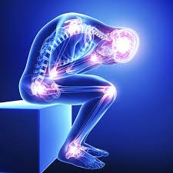
How did we get here?
For most of human history pain was considered an essential component of the human experience, unavoidable, punishment for misdeeds or lesson to test moral fortitude
Modern Medicine developed anesthesia and prescription opioids
Pain began to be seen as an avoidable component of human suffering of which the patient is the innocent victim and it’s the ethical duty of the medical provider to relieve

Slide 8

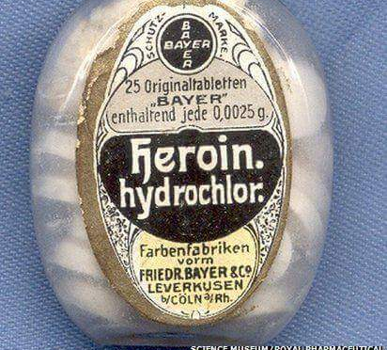


Opioids for Chronic Pain
Feared throughout human history due to common knowledge of risk of dependence and addiction
Historically times and places where opioids became widely available resulted in opioid epidemics
Push in 1980’s to liberalize prescribing for end-of-life care

Slide 9
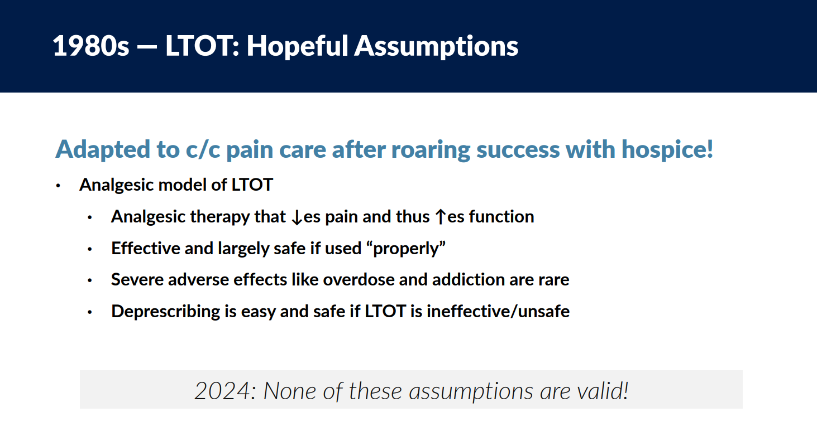
Ajay Manhapra MD, ASAM 2024

Slide 10
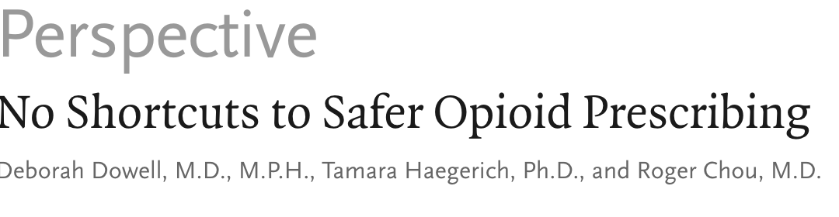

2016 Guideline Rapid Uptake: At What Cost?
An early national response addressing numerous instances of poorly applied CDC guidelines including:
  90 MME became de facto daily dose limit
  Payer-imposed barriers
  Explicit tapering plans required for high dose
  Concerns over professional risk/liability
  Alternative therapies not covered by many commercial payers (though as of today, less an issue)
“…Applications were inconsistent and went beyond its recommendations…”
Misapplication:
  Toward Populations outside of guidelines, including those receiving opiates that treat OUD
  Via imposing rigid limits and sudden tapers, causing rapid d/c or practice dismissal
What they (2016 guidelines) actually said:
  If patient is above 90, justify the decision
  The guidelines did not support abrupt discontinuation unless safety acutely an issue
¹https://healthprofessionalsforpatientsinpain.org/the-letter-1
²NEJM2019; 380:2285-2287 DOI: 10.1056/NEJMp1904190

Slide 11
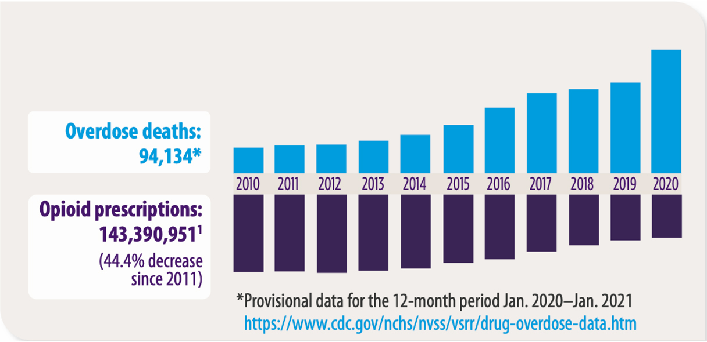
REDUCTIONS IN OPIOID PRESCRIBING
HAVE NOT LED TO REDUCTIONS IN OVERDOSE DEATHS
SOURCE: https://www.ama-assn.org/delivering-care/overdose-epidemic/physicians-progress-toward-ending-nation-s-drug-overdose-epidemic
Notes:
SPEAKER NOTES
Despite a reduction in opioid prescribing, opioid overdose deaths continue to rise. In 2020, an average of 44 people in the U.S, died per day from an overdose involving opioids. Prescription opioids were involved in 18% of all opioid overdose deaths that year, which is a 16% increase from 2019-2020 (CDC: https://www.cdc.gov/drugoverdose/deaths/prescription/maps.html). As of 2020, there are still pockets of the U.S. where prescribed opioids are influencing the number of deaths (CDC, 2021. U.S. Opioid Dispensing Rate Map. Retrieved from https://www.cdc.gov/drugoverdose/rxrate-maps/index.html). In other words, we are not done with this problem. States with prescriptions dispensed at 64.1 to 82.9 per 100 persons are Kentucky, Tennessee, Arkansas, Mississippi, Louisiana, and Alabama (CDC). [Speaker to note: If you are in any of these states, be sensitive to the audience, as they are all personally and professionally impacted by prescription opioid overdose deaths. We are not using education as a means to “call out” states, but want to help the audience with tools to help reduce these rates.]
Let’s walk through this histogram. The blue bars on the top show the number of overdose deaths in the U.S. from 2010 to 2020. The purple bars on the bottom show the number of opioid prescriptions in the U.S. over the same period. While the prescribing level has gone down, the number of overdose deaths has continued to rise at an alarming rate. The next slide will help explain why.
An additional important point to make here: Opioid use disorder has a strong relationship with suicide as compared with other SUDs. Reference: Bohnert, A., & Ilgen, M. Understanding Links among Opioid Use, Overdose, and Suicide. NEJM 2019; 380:71-79. doi: 10.1056/NEJMra1802148
References:
Demidenko, M, Dobscha, S, Morasco, B, Meath, T, Ilgen, M, & Lovejoy, T. Suicidal ideation and suicidal self-directed violence following clinician-initiated prescription opioid discontinuation among long-term opioid users. General Hospital Psychiatry. 47 (2017) 29-35. https://www.ncbi.nlm.nih.gov/pubmed/28807135. Among patients with a substance use disorder and matched controls, there are high rates of suicide ideation and self-directed violence following opioid discontinuation, suggesting that these “high-risk” patients may require close monitoring and risk prevention.
Bohnert, A, Ilgen, M, Louzon, S, McCarthy, J, & Katz, I. Substance use disorders and the risk of suicide mortality among men and women in the US Veterans Health Administration. Society for the Study of Addiction. 16 March 2017. doi: 10.1111/add.13774
Oquendo, M, & Volkow, N. Suicide: A silent contributor to opioid-overdose deaths. NEJM. 26 April 2018; 378:1567-1569. doi: 10.1056/NEJMp1801417
The percentage of opioid overdose deaths that were suicides is not well documented. But an OUD more than doubled the risk of suicide among women and increased the risk among men by 30%. It is important to screen for suicide risk in patients treated for chronic pain.

Slide 12
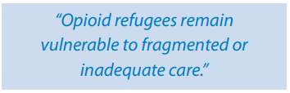
Patients who are physically dependent on opioids and who have no medical home

Slide 13
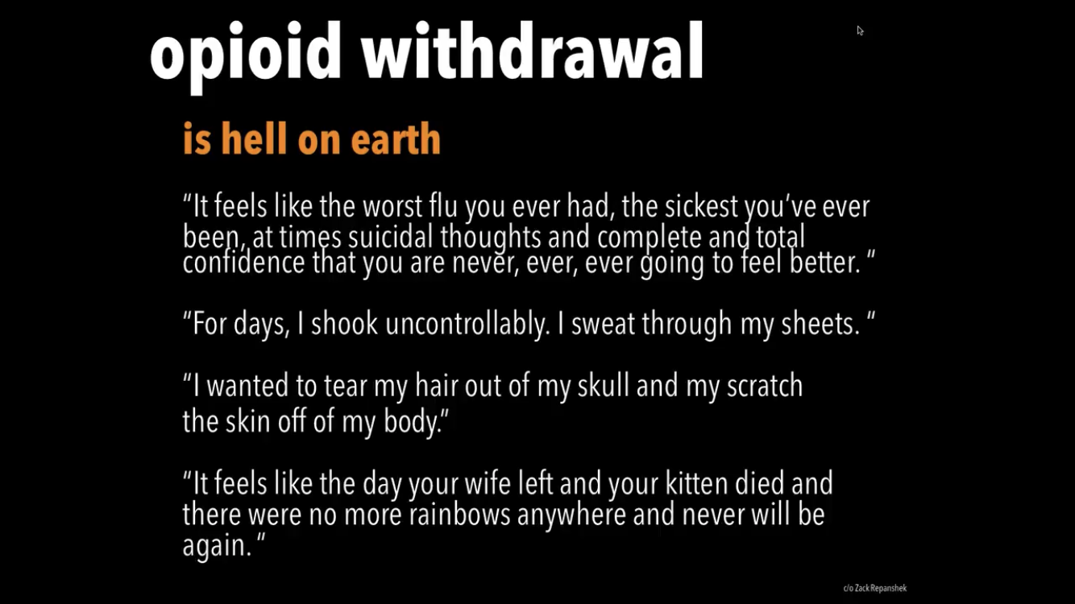
Buprenorphine in the ED: Initiating MAT for OUD, ACEP webinar, Drs Ketcham and Strayer

Slide 14
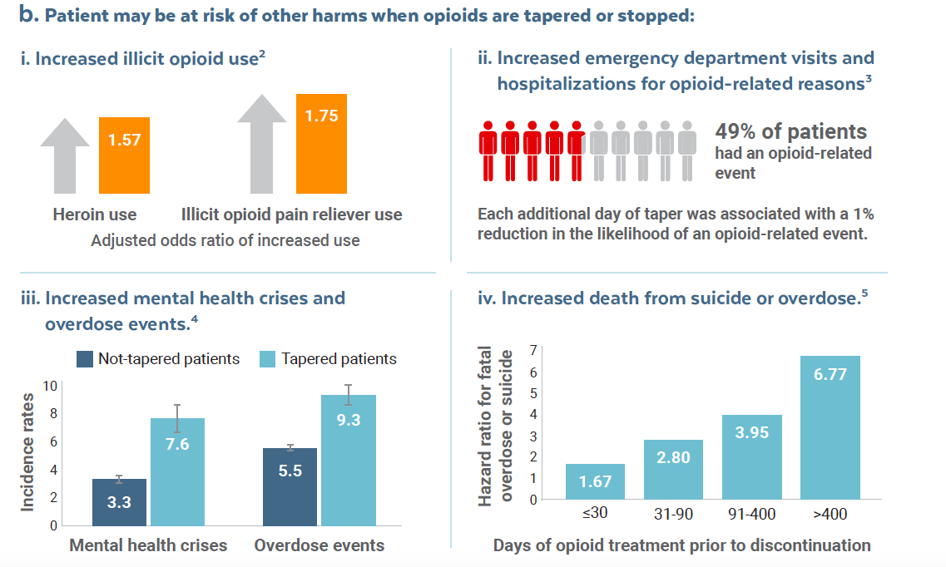
Ajay et al, 2010, Substance Abuse, Coffin et al, 2020, PLOS One, Agnoli et al, 2022, JAMA, Oliva et al, 2020, BMJ

Slide 15
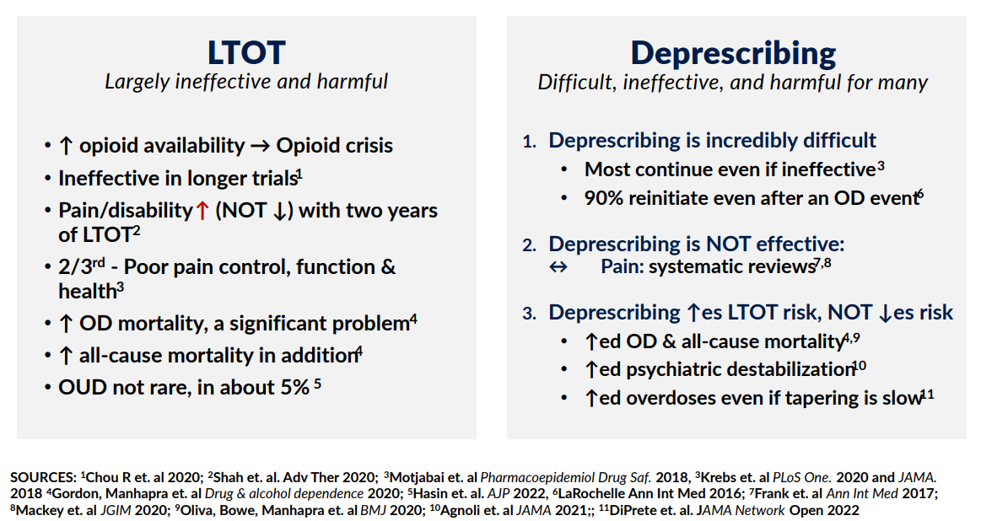
Ajay Manhapra MD, ASAM 2024

Slide 16
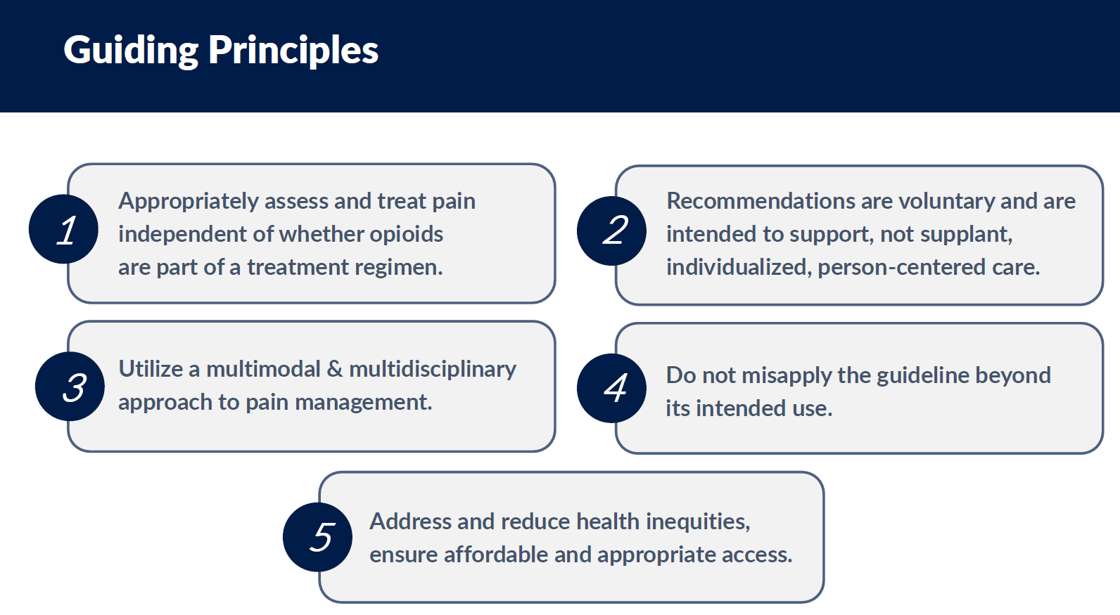
of 2022 CDC Opioid Prescribing Guidelines
Roger Chou, MD ASAM 2024

Slide 17

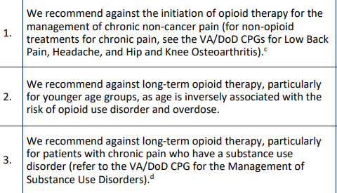
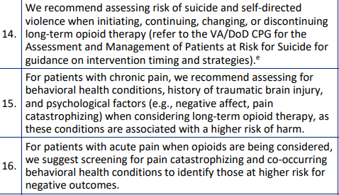
VA 2022 Guidelines
“We recommend against the initiation of opioid therapy for the management of chronic non-cancer pain”

Slide 18
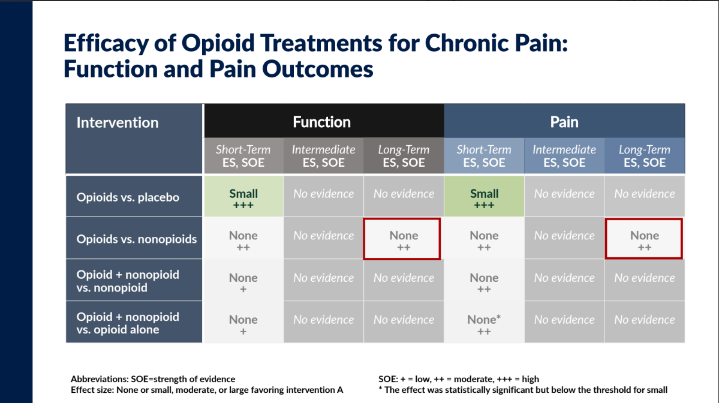
Roger Chou, MD ASAM 2024

Slide 19
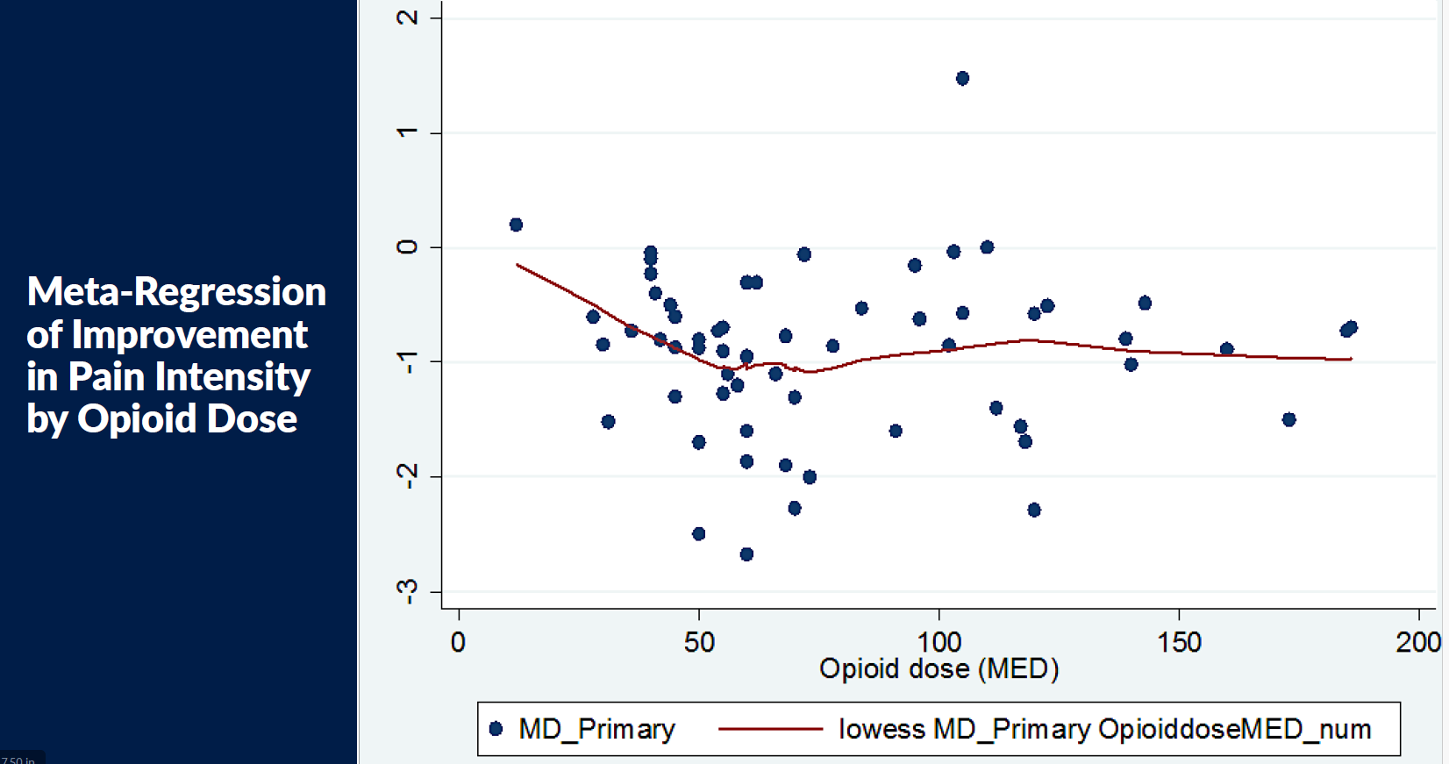
Roger Chou, MD ASAM 2024

Slide 20
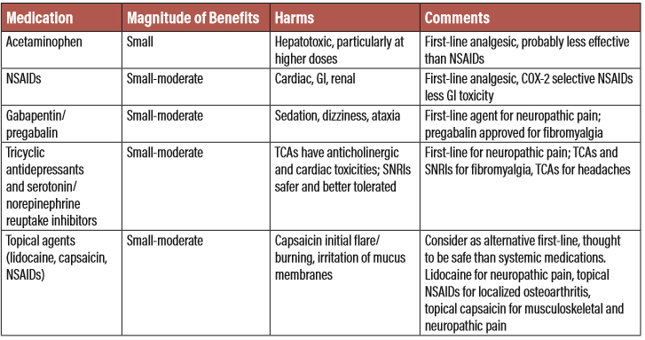
Non-narcotic medications for Chronic Pain

Slide 21
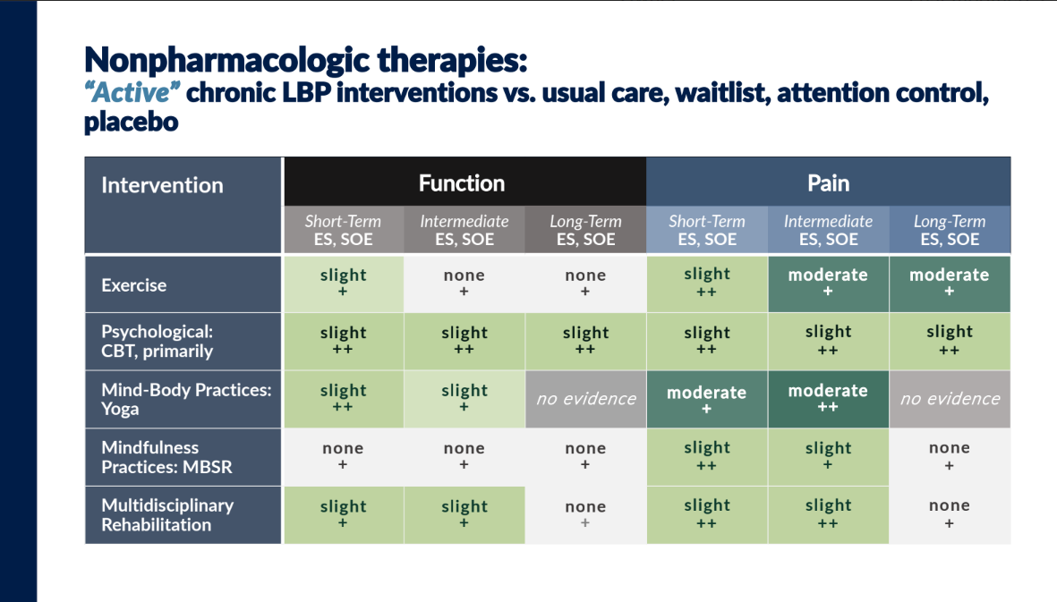
Roger Chou, MD ASAM 2024

Slide 22
ONGOING AND LONG-TERM MANAGEMENT OF PATIENTS ON OPIOID ANALGESICS
  Is the patient making progress toward functional goals?
  Reset goals if required or indicated; develop reasonable expectations
  Monitor for breakthrough pain
  Review adverse events/side effects at each visit
    Evaluate bowel function
    Screen for endocrine function as needed
    Implement opioid rotation, as indicated
Notes:
SPEAKER NOTES
• Periodically review the patient’s progress toward functional goals (the most important thing to consider in a pain treatment plan is to improve functional outcomes).
* Patient might need supplemental medication for intermittent increases in pain (breakthrough pain).
* Look for adverse events and side effects.
• We will take a closer look at some of these in a moment.

Slide 23
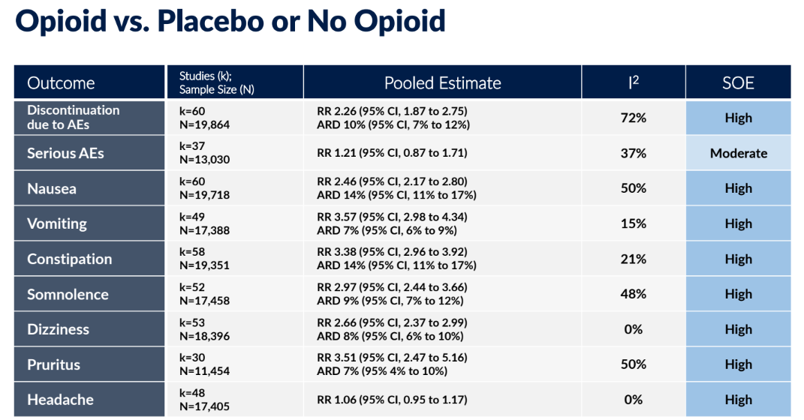
Roger Chou, MD ASAM 2024

Slide 24
PROVIDE ANTICIPATORY GUIDANCE ON OPIOID SIDE EFFECTS AND ADVERSE EVENTS
Overdose and death: respiratory depression
Opioid-induced constipation (OIC)
Nausea, vomiting, GERD
Sexual dysfunction and other endocrine abnormalities (hypogonadism)
Tolerance, physical dependence
Hyperalgesia
Allergic reactions
Sedation, cognitive impairment, depression
Falls and fractures
Sweating, miosis, urinary retention
Myoclonus (twitching or jerking)
Opioid use disorder (OUD)
Notes:
SPEAKER NOTES
This slide is anticipatory guidance for the patient and the caregivers. Proactively educate the patient and caregivers in advance. They need to be aware that any of these may occur. (We listed the side effects earlier, when introducing opioids; here it’s repeated in terms of patient education).
Know the most common side effects and their signs and symptoms.
Put in place mitigation strategies to avoid side effects, such as use of stool softeners and increasing fluids to mitigate constipation.
This image from an earlier slide is a good reminder that opioid receptors exist all over the body, which helps explain some of the side effects.

Slide 25
EMERGENCE OF OPIOID-INDUCED HYPERALGESIA
An increased sensitivity to pain
Usually occurs at high MME dosages and over long periods of time
A physiological phenomenon that can happen to anyone
Consider this explanation if:
  Pain increases despite dose increases
  Pain appears in new locations
  Patient becomes more sensitive to
  painful stimuli
  Patient is not improving in the absence of underlying
  cause or disease progression
SOURCE: Yi P, Pryzbylkowski P. Opioid induced hyperalgesia. Pain Medicine 2015; 16: S32-S36
Notes:
SPEAKER NOTES
An important consideration when converting to ER/LA opioid therapy is the fact that the patient is likely to take higher doses for a longer period of time, therefore placing themselves at risk for opioid-induced hyperalgesia.
For cancer or hospice and palliative care patients, better pain management can be achieved with lower doses, rotating between different opioids.
References:
Yi, P, Pryzbylkowski, P. Opioid Induced Hyperalgesia. Pain Medicine 2015 October, 16, S32-S36. [https://doi.org/10.1111/pme.12914]
Compton, P. Why painkillers sometimes make the pain worse. Science. 2016 November 3. [https://www.sciencemag.org/news/2016/11/why-painkillers-sometimes-make-pain-worse]
Dolnikov, E. The paradoxical phenomenon of opioid induced hyperalgesia. Israeli Pain and Palliative Care 2012 April. [http://www.medicalmedia.co.il/publications/ArticleDetails.aspx?artid=5395&sheetid=370]

Slide 26
Selecting Opioids and Determining Opioid Dosages
Recommendation 5
For patients already receiving opioid therapy, clinicians should carefully weigh benefits and risks and exercise care when changing opioid dosage. If benefits outweigh risks of continued opioid therapy, clinicians should work closely with patients to optimize nonopioid therapies while continuing opioid therapy. If benefits do not outweigh risks of continued opioid therapy, clinicians should optimize other therapies and work closely with patients to gradually taper to lower dosages or, if warranted based on the individual circumstances of the patient, appropriately taper and discontinue opioids. Unless there are indications of a life-threatening issue such as warning signs of impending overdose (e.g., confusion, sedation, or slurred speech), opioid therapy should not be discontinued abruptly, and clinicians should not rapidly reduce opioid dosages from higher dosages (recommendation category: B; evidence type: 4).

Slide 27
Endogenous Opioid Receptor Homeostasis and Stress Response

Slide 28
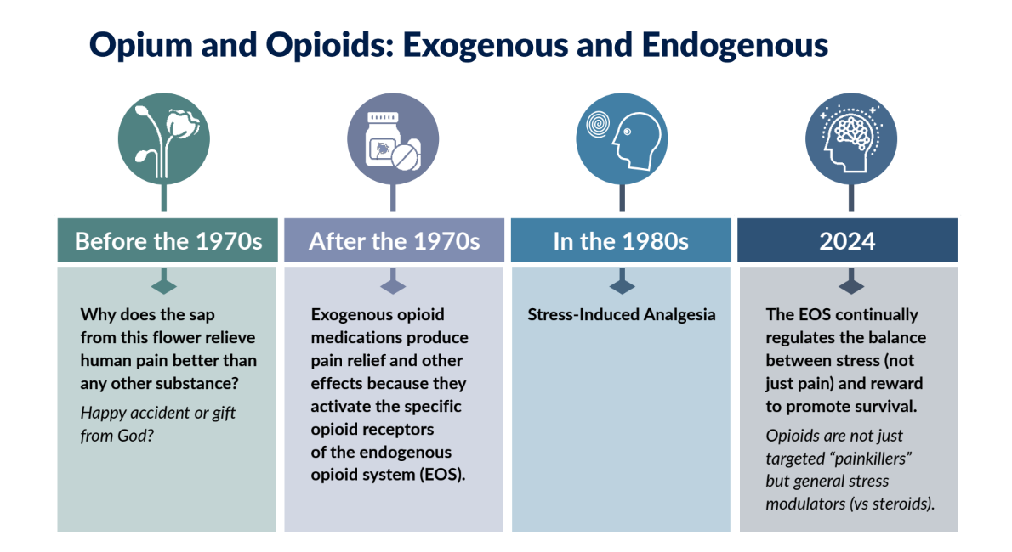
Mark Sullivan, MD, PhD ASAM 2024

Slide 29
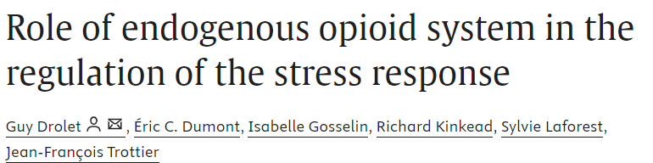
A distinctive feature of the analgesic action of opioids is the blunting of the distressing, affective component of pain without dulling the sensation itself. Therefore, opioid peptides may diminish the impact of stress by attenuating an array of physiologic responses including emotional and affective states.
https://www.sciencedirect.com/science/article/abs/pii/S0278584601001610

Slide 30
Opioids are general stress modulators
The mechanical model of pain attempts to separate pain from the rest of human suffering as uniquely medical
Opioid use to relieve physical pain is deemed “legitimate”, while use to treat emotional pain is improper “abuse”
Chronic pain is often co-morbid with depression, anxiety and PTSD
Patients with co-morbid mental illness are more likely to be prescribed LTOT, at higher doses and for longer periods, often with co-prescribed sedative
Endogenous opioids are one of the main stress modulators in the brain and support social & emotional function
“Heroin felt a hug from God…I got an immediate and intense relief from suffering…I felt absolutely safe”
“It is not possible to aim prescription opioids at physical pain only and not at the whole of human suffering, nor to distinguish which of these is being treated”
-The Right to Pain Relief, Mark Sullivan

Slide 31
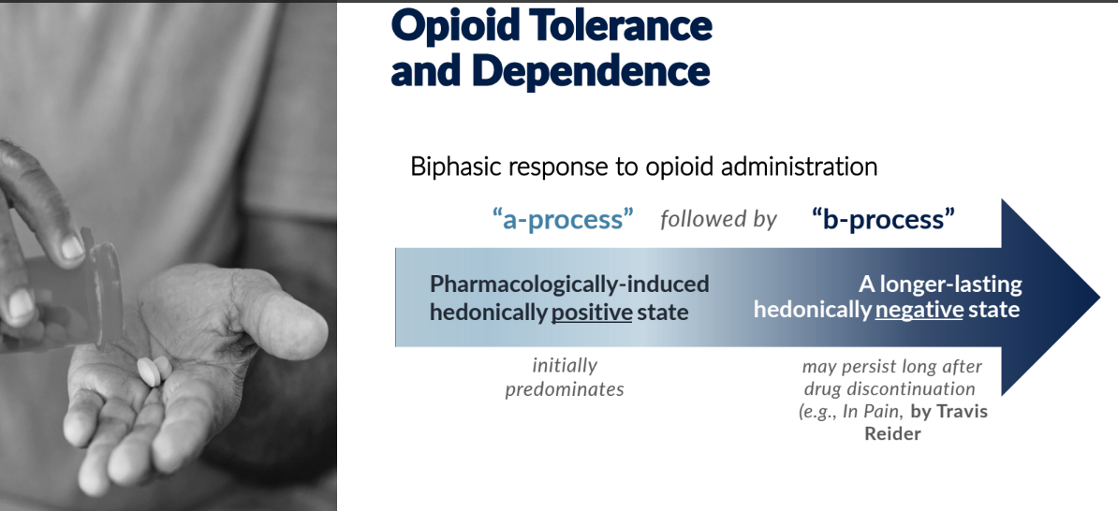
The body is continuously seeking homeostasis
Mark Sullivan, MD, PhD ASAM 2024

Slide 32
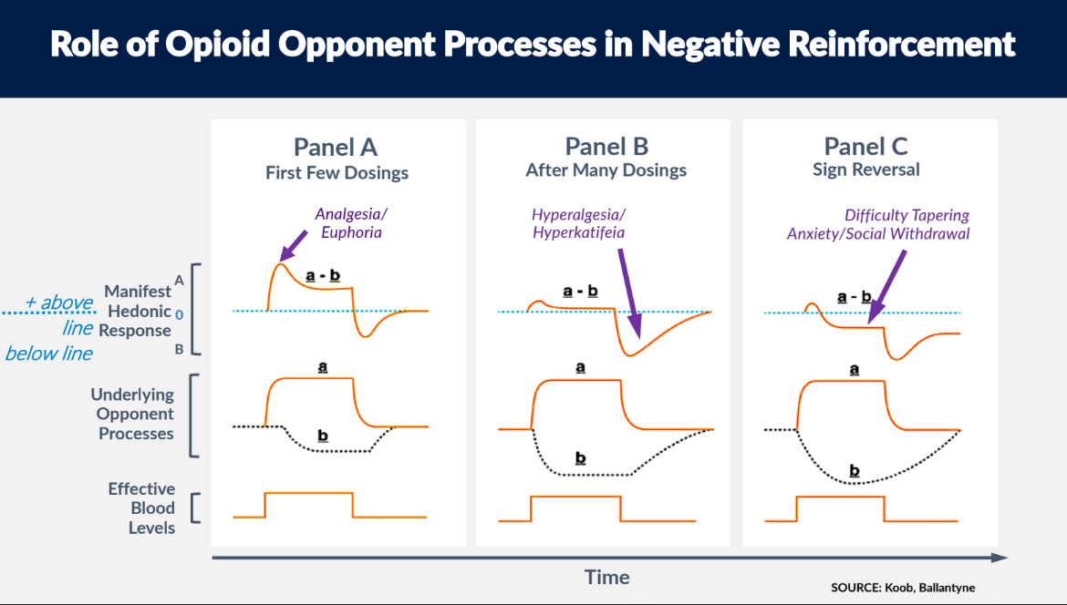
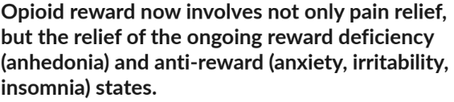
Mark Sullivan, MD, PhD ASAM 2024

Slide 33
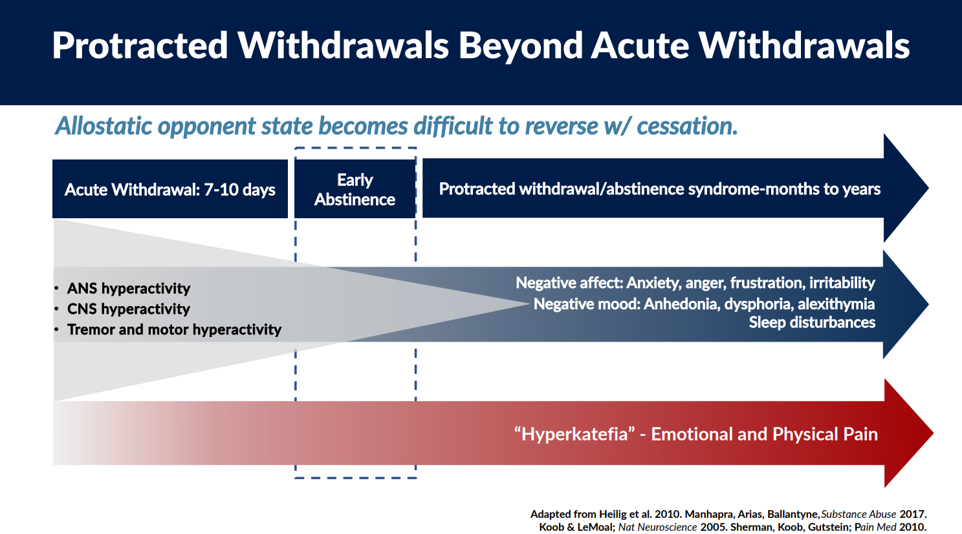
Ajay Manhapra MD, ASAM 2024

Slide 34
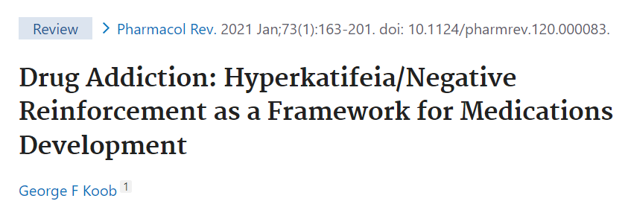
Hyperkatifeia:
A greater intensity of negative emotional/motivational signs and symptoms during withdrawal from drugs of abuse in the withdrawal/negative affect stage of the addiction cycle. Hyperkatifeia provides an additional source of motivation for compulsive drug seeking via negative reinforcement. Negative reinforcement reflects an increase in the probability of a response to remove an aversive stimulus or drug seeking to remove hyperkatifeia that is augmented by genetic/epigenetic vulnerability, environmental trauma, and psychiatric comorbidity

Slide 35
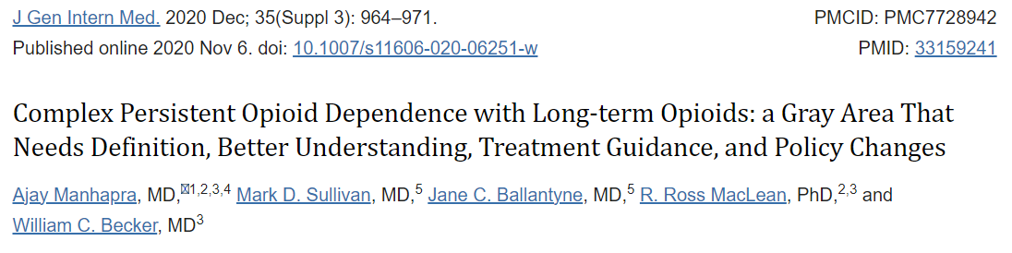
The recent recognition of LTOT inefficacy and complications has led to more frequent opioid tapering, which in turn has revealed its own set of complications. The occurrence of the same set of symptoms—worsening pain, declining function, and clinical instability—in contrasting contexts of LTOT ineffectiveness and opioid tapering has led to increasing recognition of the utility of complex persistent opioid dependence (CPOD), a clinically distinct but biologically similar state compared with opioid use disorder
https://www.ncbi.nlm.nih.gov/pmc/articles/PMC7728942/

Slide 36
“As physical opioid dependence emerges from repeated cycles of pain and relief from opioids, the opponent effect (pain) after each opioid dose administration could grow in magnitude and duration; the resultant net pain relief after each opioid dose administration can be short-lived and of low magnitude, followed by rebound to a higher level of pain. It is hypothesized that the allostatic process accompanying the opponent process (allostatic opponent effect) in CPOD resets the baseline pain experience of the individual to higher levels despite increasing opioid dose. Additionally, the corresponding neurobiological changes that sustain and escalate opioid dependence and allostatic opponent effect become difficult to reverse. Opioid dose reduction or cessation in such situations with advanced CPOD could result in protracted withdrawal syndrome associated with persistence of the opponent effect (worsened pain)”
https://www.ncbi.nlm.nih.gov/pmc/articles/PMC7728942/

Slide 37
The development of the CPOD diagnosis comes with a risk of it being misinterpreted by healthcare entities and governmental agencies as an “addiction equivalent” which could generate more stigma and risk of abandonment for patients on LTOT. In our conception, CPOD is an iatrogenic syndrome for which healthcare systems should bear the onus for change. Any new guidance regarding CPOD should be cautious to avoid transferring the stigma and fear related to the confusion of “opioid dependence” and OUD among patients on LTOT
https://www.ncbi.nlm.nih.gov/pmc/articles/PMC7728942/

Slide 38
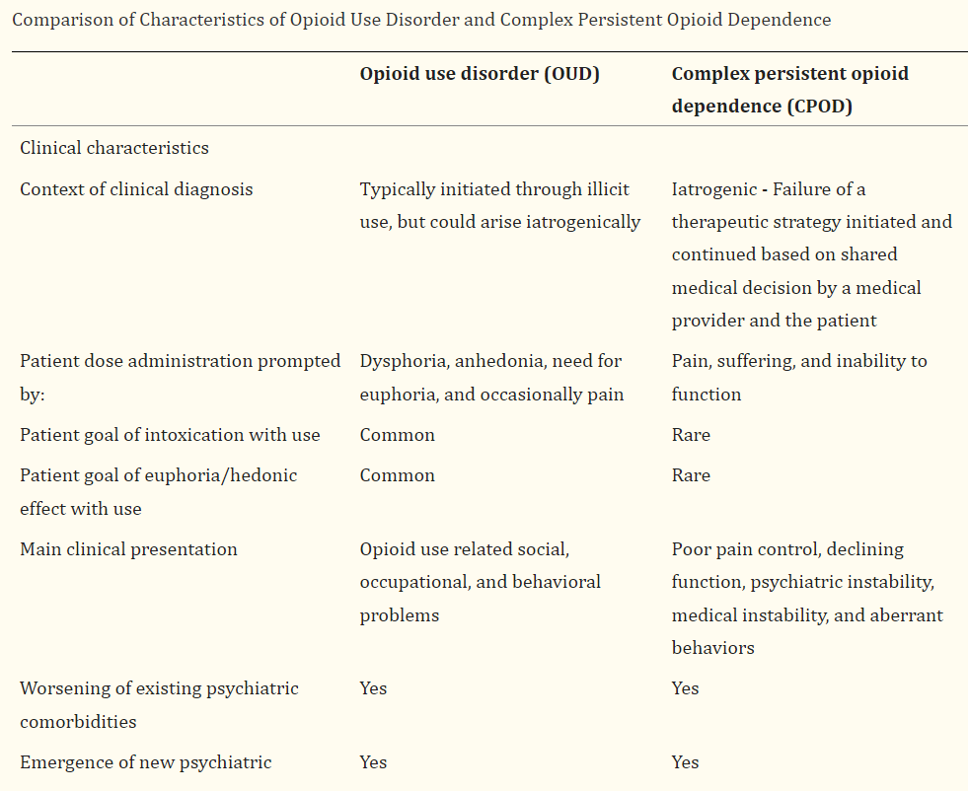

Slide 39
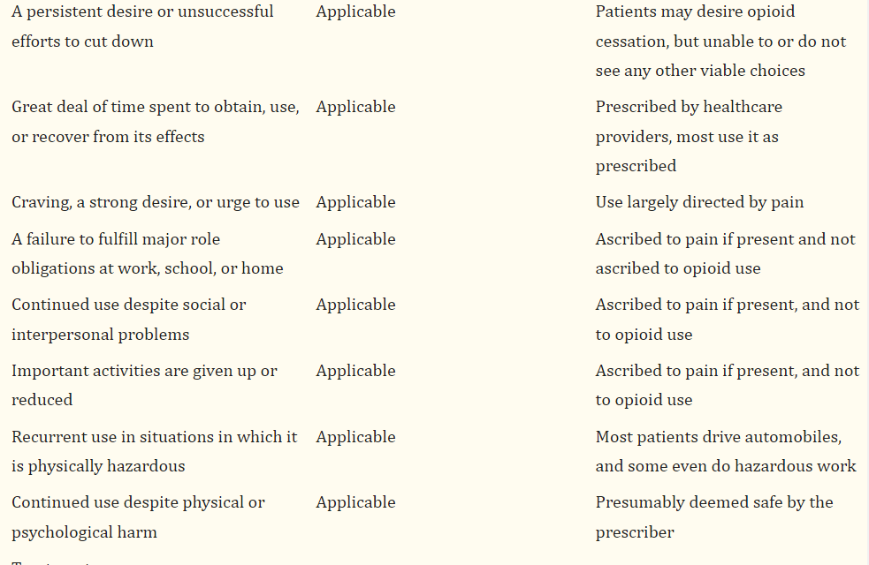

Slide 40
How can we help patients with CPOD?

Slide 41
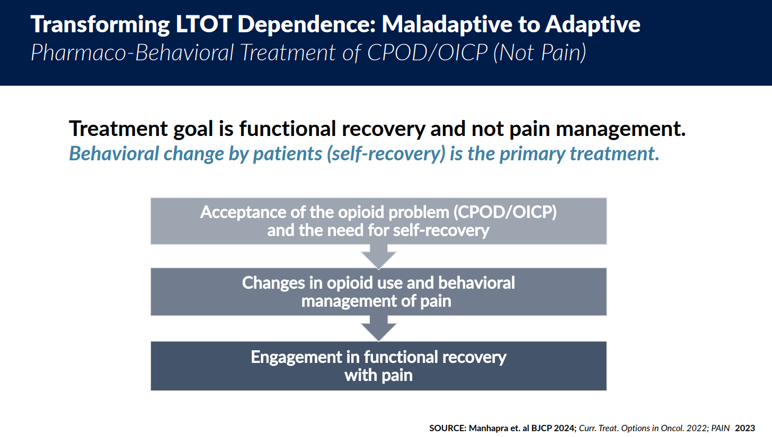
Ajay Manhapra MD, ASAM 2024

Slide 42
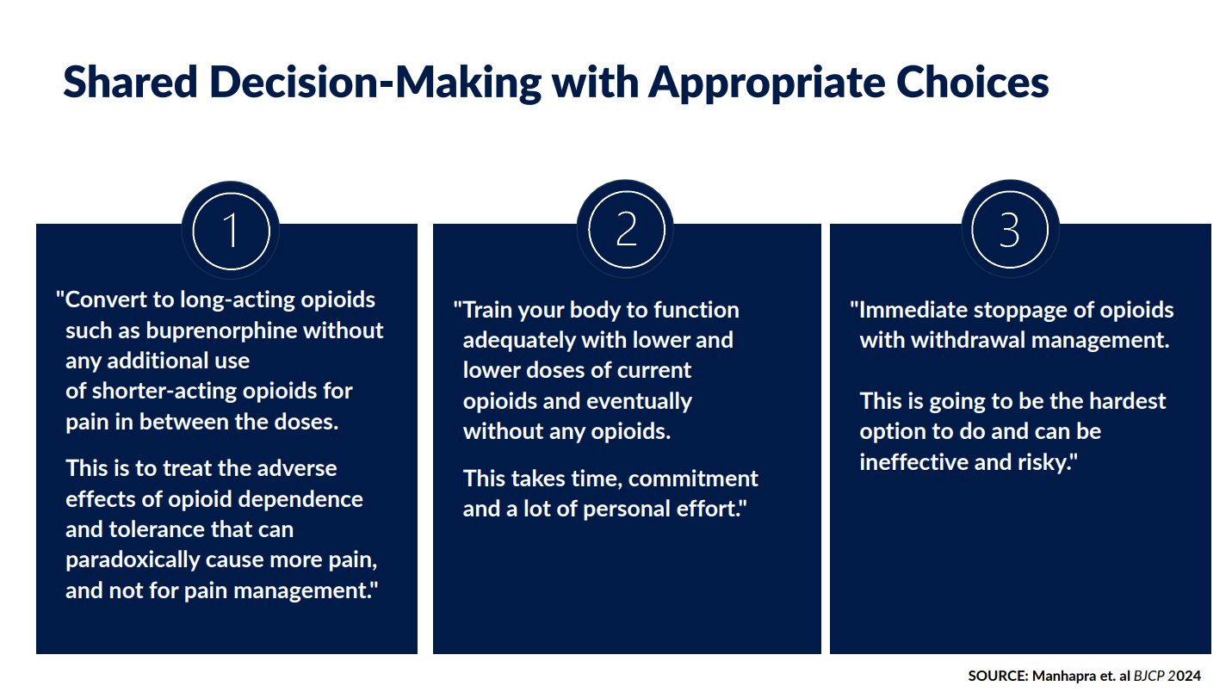
Ajay Manhapra MD, ASAM 2024

Slide 43
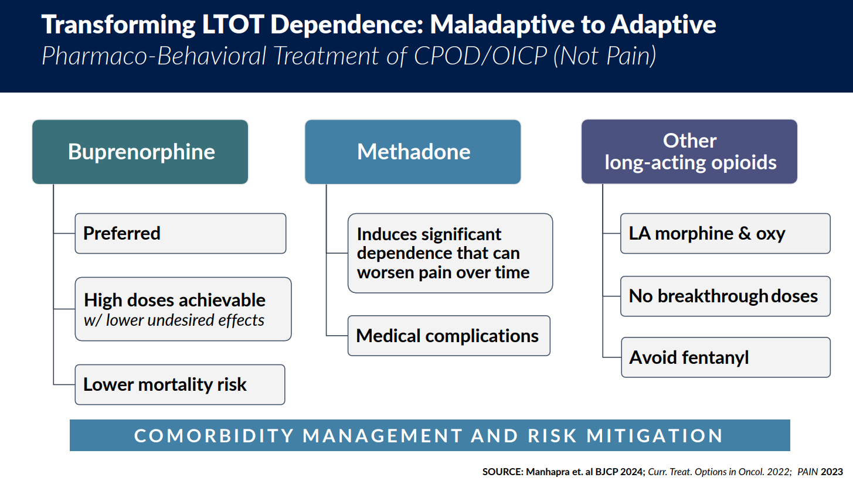
Ajay Manhapra MD, ASAM 2024

Slide 44
Tapering Chronic Opioids

Slide 45
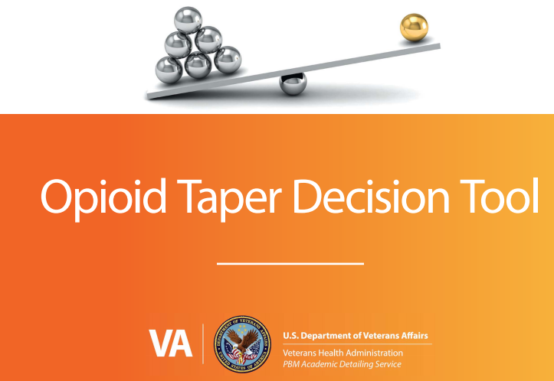
https://www.pbm.va.gov/AcademicDetailingService/Documents/Pain_Opioid_Taper_Tool_IB_10_939_P96820.pdf

Slide 46
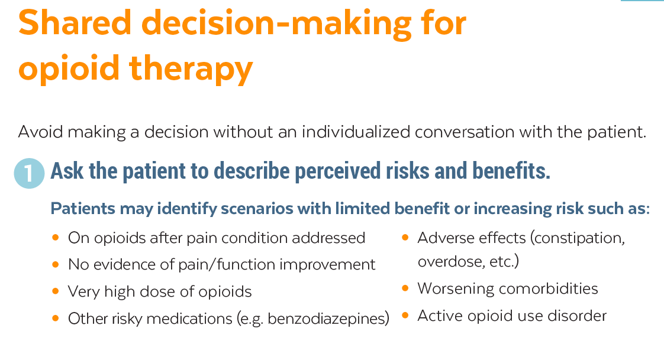

Slide 47
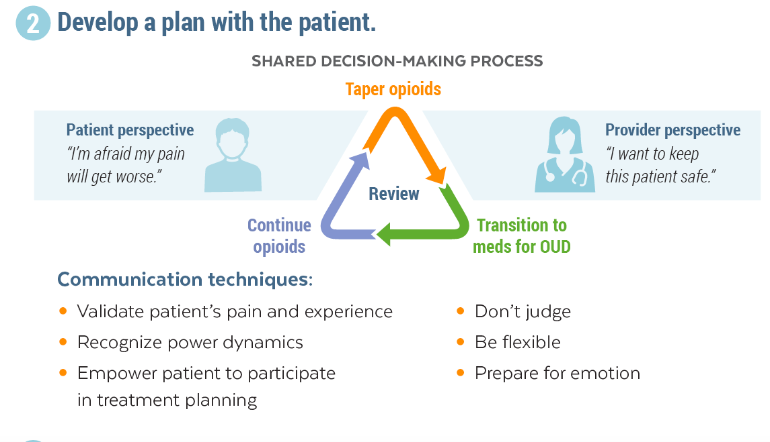

Slide 48
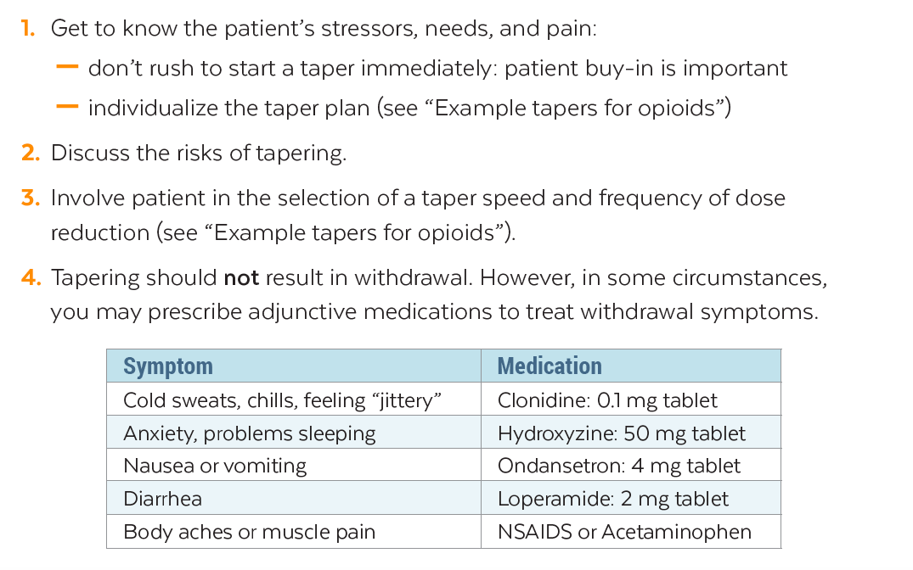

Slide 49

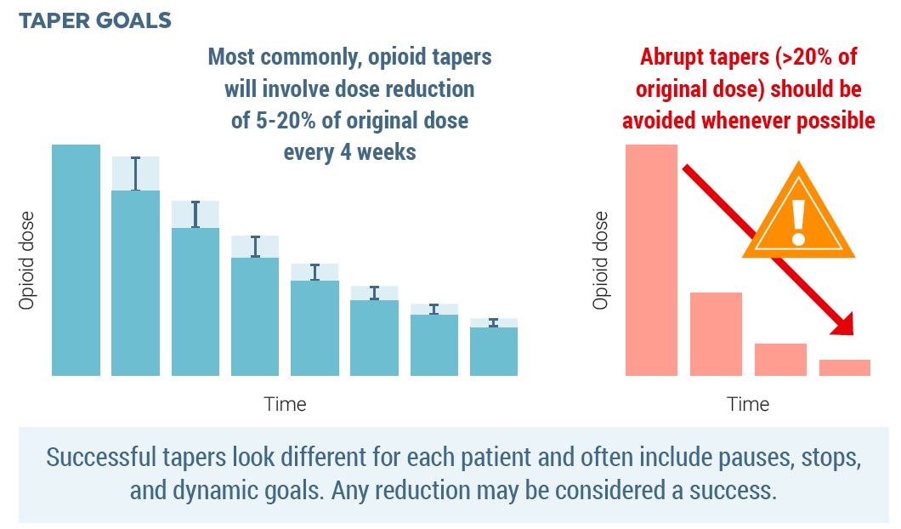

Slide 50
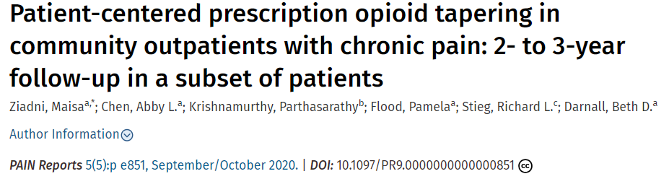
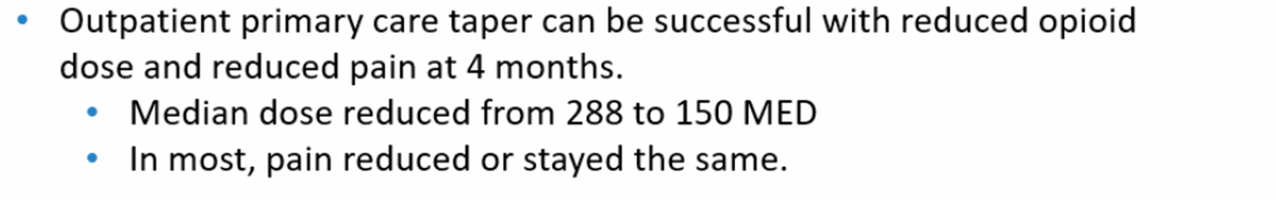
https://doi.org/10.1097%2FPR9.0000000000000851

Slide 51
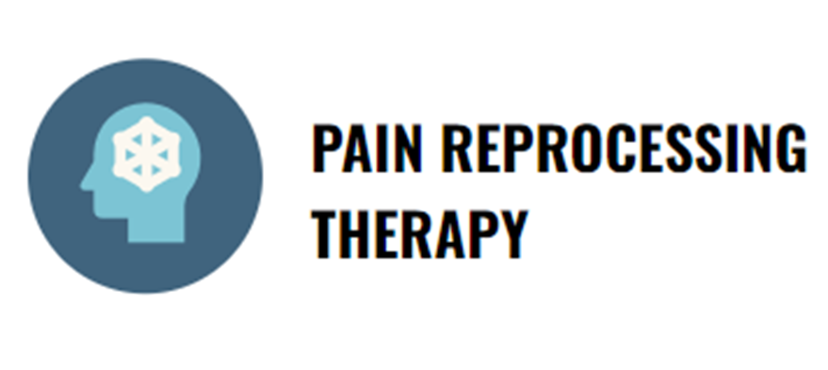
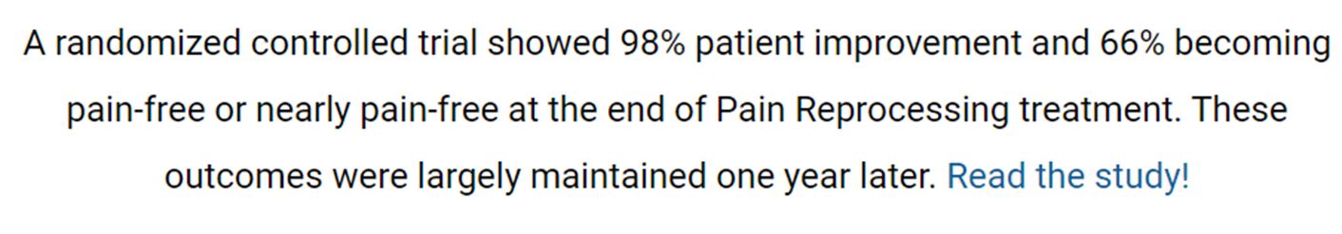
https://www.painreprocessingtherapy.com/

Slide 52
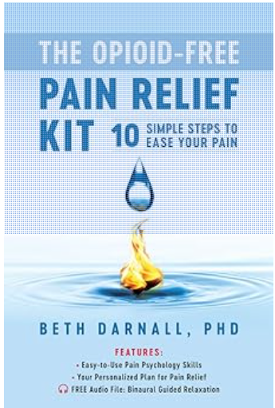
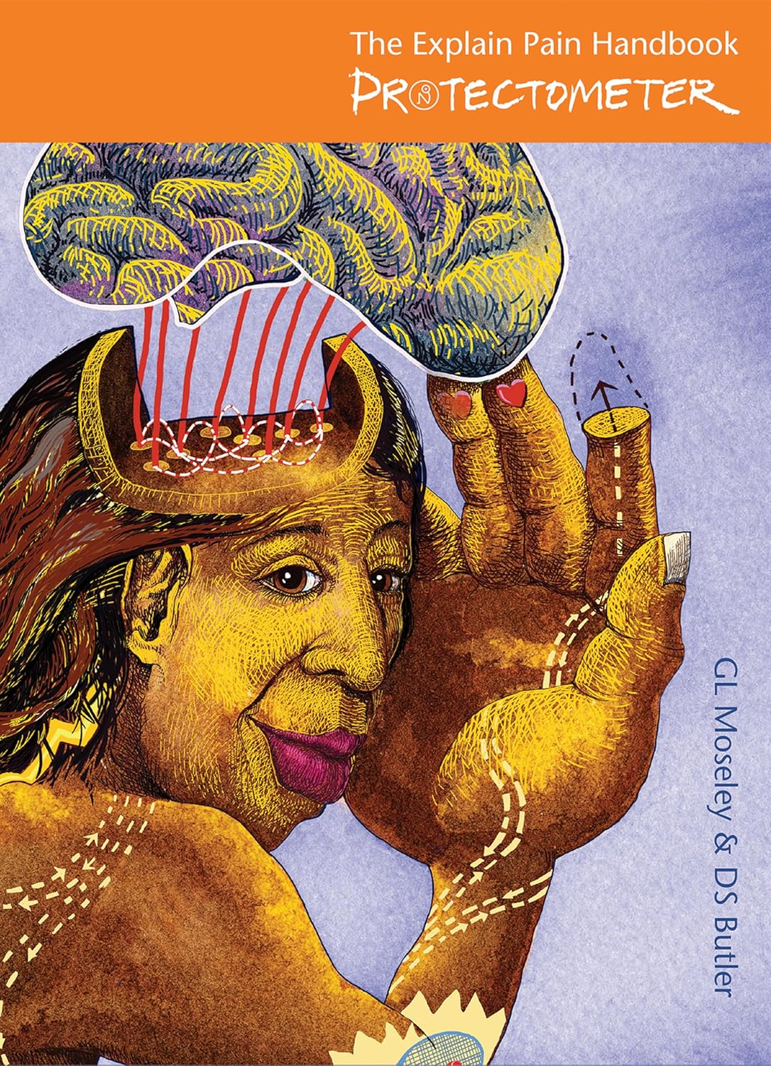
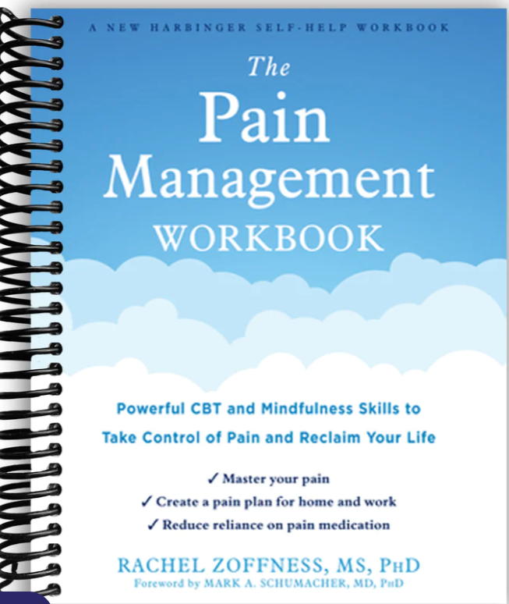

Slide 53
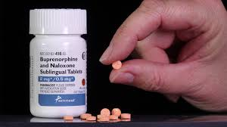
Buprenorphine for CPOD

Slide 54
Buprenorphine was proposed as a treatment for CPOD based on the hypothesis that an advanced level of opioid dependence drives clinical instability characteristics of both CPOD and OUD. There is evidence that buprenorphine can provide analgesia for chronic pain including sublingual buprenorphine/naloxone preparations approved for OUD treatment. However, conclusive evidence regarding the effectiveness and safety of sublingual buprenorphine/naloxone for CPOD and chronic pain awaits prospective randomized trials.

Slide 55
Management of Opioid Misuse That Does Not Meet Criteria for Opioid Use Disorder
Clinicians can have challenges distinguishing between opioid misuse behaviors without opioid use disorder and mild or moderate opioid use disorder. For patients with opioid misuse that does not meet criteria for opioid use disorder (e.g., taking opioids in larger amounts than intended without meeting other criteria for opioid use disorder), clinicians should reassess the patient’s pain, ensure that therapies for pain management have been optimized (see Recommendation 2), discuss with patients, and carefully weigh benefits and risks of continuing opioids at the current dosage (see Recommendation 5). For patients who choose to but are unable to taper, clinicians can reassess for opioid use disorder and offer buprenorphine treatment or refer for buprenorphine or methadone treatment if criteria for opioid use disorder are met. Even without a diagnosis of opioid use disorder, transitioning to buprenorphine for pain also can be considered because of reduced risk for overdose with buprenorphine compared with risk associated with full agonist opioids (see CDC Recommendation 5).

Slide 56
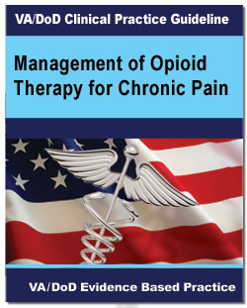
VA 2022 Guidelines
For patients receiving daily opioids for the treatment of chronic pain, we suggest the use of buprenorphine instead of full agonist opioids due to lower risk of overdose and misuse.
https://www.healthquality.va.gov/guidelines/Pain/cot/VADoDOpioidsCPGProviderSummary.pdf

Slide 57
Buprenorphine for Pain = Risk Reduction
Buprenorphine can be used for chronic noncancer pain and could be preferable to other options in patients with higher risks of toxicity (eg, elderly patients, patients with COPD, OSA, CVD, renal and hepatic dysfunction)
Strongly consider transitioning patients on chronic full opioid agonists to buprenorphine to reduce opioid related risks
https://www.hhs.gov/opioids/sites/default/files/2019-10/Dosage_Reduction_Discontinuation.pdf

Slide 58
Which patients on chronic opioid therapy may benefit from being transitioned to buprenorphine?
Patients who find that protracted opioid withdrawal symptoms are unbearable when attempting an opioid taper
Patients at high risk for opioid/sedative related morbidity or mortality on their current therapy
Patients with opioid induced hyperalgesia??? Or other current opioid induced symptoms (depression, cognitive impairment, somnolence)
Patients with opioid use disorder

Slide 59
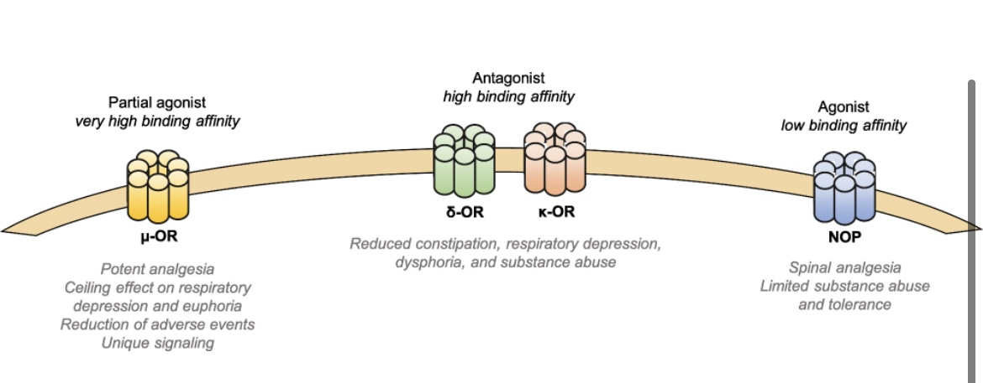
Buprenorphine’s actions on opioid receptors
Antagonist effect at the Kappa receptor likely related to antidepressant effect

Slide 60
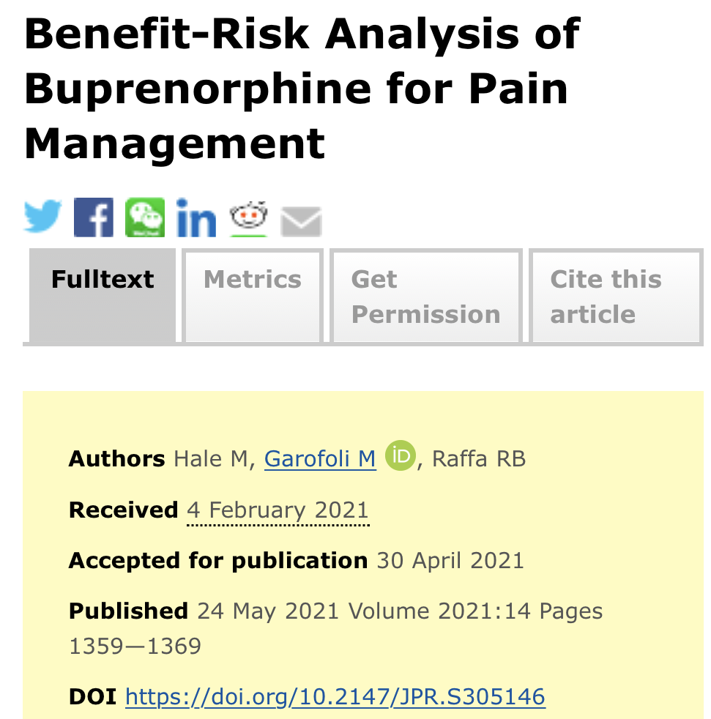
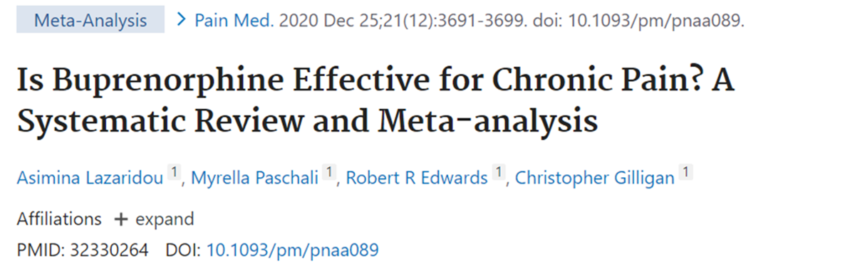
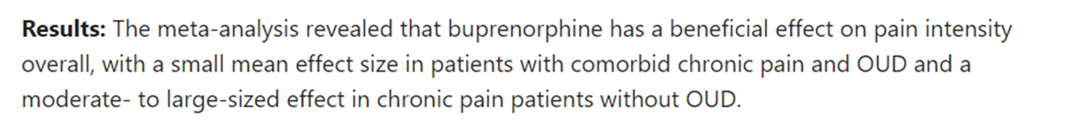
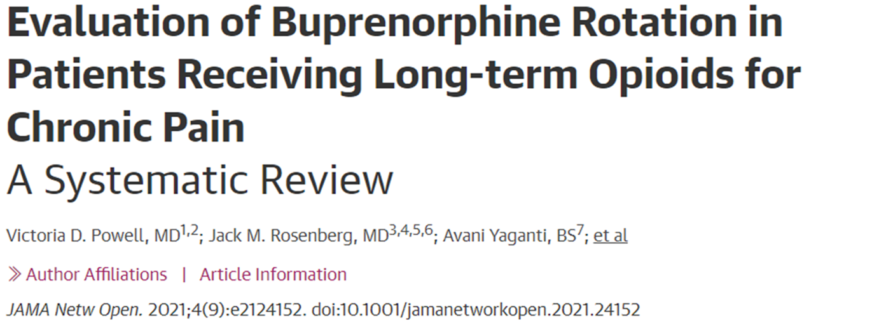
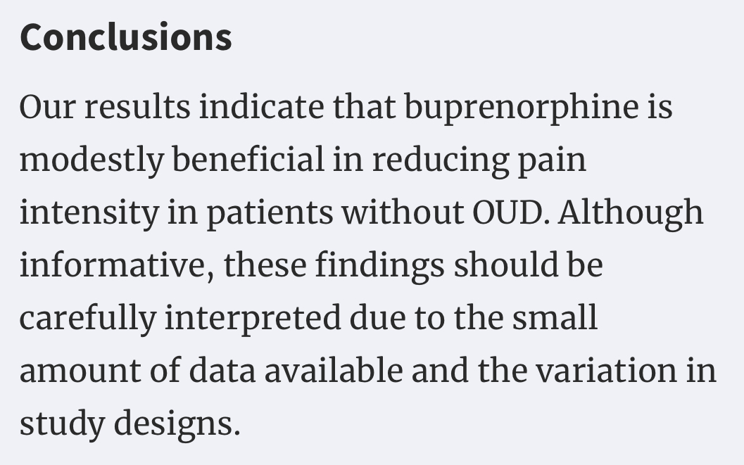


Slide 61

https://www.tandfonline.com/doi/pdf/10.2147/JPR.S231948

Slide 62



35 patients, ave 550 MME, converted to 2–20 mg (mean 8 mg) of buprenorphine, followed for 6 months.
Patients converting off higher opioid doses enjoyed a greater average improvement in quality of life score.
https://doi.org/10.1111/pme.12520

Slide 63


https://www.tandfonline.com/doi/pdf/10.2147/JPR.S231948

Slide 64


FDA approved formulations of buprenorphine for chronic pain
Consider off label use of sublingual buprenorphine or bup/naloxone for patients with higher levels of tolerance whose pain is uncontrolled, or when cost is a barrier

Slide 65
BUPRENORPHINE FORMULATIONS
Formulation | Transdermal patch | Buccal film | SL tab or film
Max Strength | 20 mcg/hr (0.5mg/day) | 900mg bid (1.8mg/day) | 2mg or 8mg tid (24mg)
FDA approved for pain | Yes | Yes | No
Transition from max MME | <30-80 | <160 | No Max
Price per month | $900 | $1,080 | $750 ($100 bup mono tabs)
Abuse Deterrent form available | Inherent in formulation | No | Yes Rx combo product with nlx

Slide 66
Although it is legal to prescribe sublingual buprenorphine off label for pain, not all insurances cover this medication (it’s more expensive than regular opioids).
Some insurances only cover buprenorphine patch (Butrans – covered by Medicaid) or buccal film (Belbucca), these formulations are low-dose and appropriate for patients with lower levels of opioid tolerance
Chronic pain patients with higher levels of tolerance (>50-100 MME) may need sublingual buprenorphine tablets or film (films easier to cut), also allows for prn dosing. Combo products (with naloxone) have lower diversion and abuse risk and may be suitable to use in patients with pain, slightly higher incidence of nausea.
(ASAM 2020 guidelines and HHS Guide for Clinicians on the Appropriate Dosage Reduction or Discontinuation of Long-Term Opioid Analgesics 2019)

Slide 67
Insurance will usually cover SLBUP for Pain
with PA indicating medical necessity
Example: Patient with multiple comorbidities on high dose chronic opioids, needing to change/taper for safety concerns (at risk for respiratory suppression) or side effects, but unable to tolerate opioid taper, buprenorphine can reduce overdose risk.
(CDC 2022 opioid guidelines, VA 2022 opioid guidelines, ASAM 2020 guidelines and HHS Guide for Clinicians on the Appropriate Dosage Reduction or Discontinuation of Long-Term Opioid Analgesics 2019)

Slide 68
Summary of CPOD Management
LTOT risk and outcome management need to shift from opioid dose-based strategies to whole-person centered strategies that acknowledge the impact of CPOD
Build awareness and create educational resources about CPOD
Discourage patient abandonment
Focus pharmacotherapy on risk reduction and treatment of opioid tolerance and dependance to improve function
Provide patient with resources to support their acceptance of the opioid problem and the need for behavioral change to engage in function recovery, learning to live with pain.

Slide 69
Sarah Spencer DO, FASAM
Ninilchik Community Clinic
Ninilchik, Alaska
sarahspencerak@gmail.com
907-299-7460

