Slide 1
Wellness in Recovery Integrating Nutrition and Lifestyle interventions for healing Body and mind in REcovery
Amy de la Garza, MD, FASAM, IFMCP
Region 10 Opioid Summit
July 26, 2024

Slide 2
Disclosures
I have no financial disclosures
I will not be discussing off label use of any medications
I might say some things that are not popular ☺

Slide 3
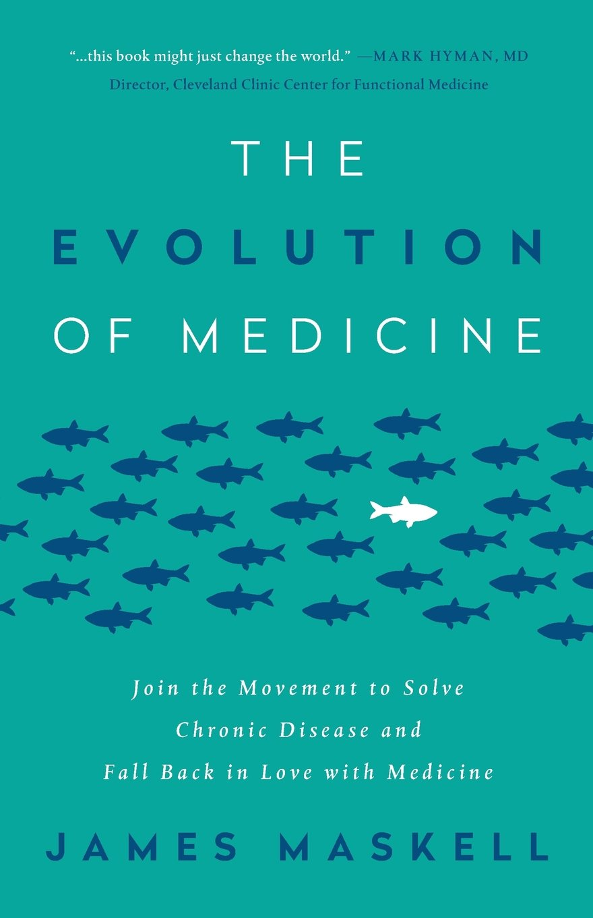
2016 THE EVOLUTION OF MEDICINE JAMES MASKELL 2017 Equilibrium and Heron Medical

Slide 4
Functional Medicine
EVIDENCE-BASED, EVIDENCE INFORMED
PROVIDER AS GUIDE
PATIENT CENTERED
FOCUSED ON WELLNESS AND HEALING
Notes:
This is not woo medicine – it is rooted in evidence, especially around lifestyle related changes
Provider as guide – reducing this paternalistic, “prescribed” type of treatment
This is patient centered focused on listening and gathering a patients story – including their Family History and Origin Stories – taking into account intergenerational physical and behavioral health concers – as this affects how are genes are expressed – epigenetics – the CONTEXT of the development of symptoms and diagnoses – keeping in mind that 90% of our visits to our doctors is secondary to stress – trauma and stress gets “stuck” in the body as physical illness – Tanaya talked about this yesterday – and what does their life look like today – really understanding where they are and meeting them there when we formulate treatment plans
This is wellness and healing – this is an active process, a pursuit of healing in the physical, mental, spiritual and RELATIONAL domains. It is not symptom management, it is not disease eradication -

Slide 5
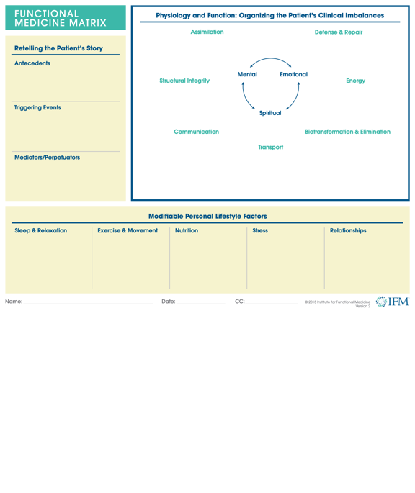
Modifiable Lifestyle Factors
NUTRITION
SLEEP
MOVEMENT
MITIGATING THE EFFECTS OF STRESS
COMMUNITY AND CONNECTION

Slide 6
“Old wisdom from the recovery community would suggest that a liberalized approach to sweets, nicotine and caffeine is favorable to help the individual get past the immediate crisis. New wisdom suggests that this behavior is a form of cross addiction that should be addressed early in recovery.” David Wiss MS RDN

Slide 7
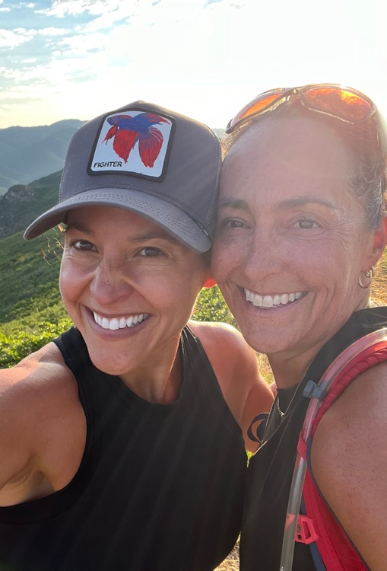
Building the case building trust
July 2019 Addiction Fellowship University of Utah
March 2020 COVID
2020-2021 Odyssey House Ear Acupuncture and Wellness in Recovery
June 2021 Addiction Update Utah Complementary and Integrated Care for SUD
August 2021 – California Society of Addiction Medicine – Widening the Lens Workshop Virtual
August 2022 – CSAM – Integrative Care for Substance Use Disorder
October 2023 - Utah State University Rural Opioid and Stimulant Wellness Summit, Price, UT. - Complementary Treatments for Addiction, Trauma, and Stress with Elizabeth Howell, MD. – TRACI POLE!!!!!!
February 2024 – Mind Pivot – Mountain Plains Rural Opioid Technical Assistance Center (MP ROTAC) SAMSHA Region 8
Today- Region 10 Keynote on Wellness in Recovery – SO HAPPY!!!!

Slide 8
Want more information!!!
MIND PIVOT MICROTRAININGS! Starting July 11 at 12 PM
WEEKLY for 12 WEEKS
Building upon our successful Mind Pivot: Integrating Nutritional Interventions for Healing Body and Mind in Recovery series in February, we are pleased to host a 12-week series of dynamic micro-trainings, designed to teach anyone working in the healthcare, addiction, and recovery fields how to implement evidence-based strategies that can not only enhance your well-being but also provide tools to integrate into your patient/client care.
https://wiche.zoom.us/meeting/register/tJcvdeGqrjojH9TI5PQfCkVT6ALdBPy4uNhj

Slide 9
What this Presentation IS NOT
A DISCUSSION ABOUT WEIGHT
A JUDGEMENT ABOUT FOOD OR LIFESTYLE CHOICES
AN ALTERNATIVE TO EVIDENCE-BASED ALLOPATHIC AND CLINICAL INTERVENTIONS FOR TREATMENT – THIS IS COMPLEMENTARY BUT IMPERATIVE TO ALL TREATMENT
A RECOMMENDATION FOR AN EXPENSIVE, CULTURALLY INSENSITIVE, INACCESSIBLE, OUT OF REACH INTERVENTION FOR YOU OR YOUR PATIENTS/CLIENTS
Notes:
70% OF WOMEN – ESPECIALLY WHO USE STIMULANTS GOT STARTED BECAUSE OF WEIGHT CONCERNS AND TO DEAL WITH THE COMPLEXITIES OF BEING OF WOMAN, WORK, HOME LIFE , CHILD REARING - AMPHETAMINES WERE PRESCRIBED TO WOMEN IN THE 60 AND 70’S FOR PRECISELY THIS REASON!!!!! – THIS IS DEEPLY EMBEDDED IN OUR CULTURE
JUDGEMENT – WE ARE SET UP FOR THIS – FOOD AND PHARMACY ON TV, FOOD AT THE HARDWARE STORE, FOOD AT THE BOOKSTORE, FOOD AT SCHOOL, FOOD AT THE HOSPITAL AND MENTAL HEALTH AND TREATMENT
THIS IS COMPLEMENTARY BUT IMPERATIVE TO TREATMENT
STORY ABOUT THE WOMAN WHO CHANGED THE WAY SHE FED HERSELF AND HER CHILDREN USING SNAPS – 150 POUND WEIGHT LOSS

Slide 10
WHAT THIS PRESENTATION IS
A DISCUSSION ABOUT HOW WE CAN LEVERAGE FOOD AS MEDICINE
A DISCUSSION ABOUT WHY THIS REALLY IS IMPORTANT TO PEOPLE
A DISCUSSION ABOUT HOW ACCESSIBLE SMALL CHANGES REALLY ARE AND WHAT A HUGE DIFFERENCE THEY CAN MAKE!!!
A MESSAGE OF HOPE
A CALL TO ACTION
https://www.youtube.com/watch?v=fEKlDJ_o3Fg
VERNAL OPIOID SUMMIT STORY
Notes:
NEW YORK CITY MAYOR ERIC ADAMS
PRIOR BROOKLY BOROUGH PRESIDENT
TYPE 2 DIABETES , OVERWEIGHT – ADOPTED A PLANT BASED LIFESTYLE – VEGAN VS PLANT BASED
OFFERING CULTURALLY SENSITIVE, PLANT BASED MEAL OPTIONS IN NEW YORK CITY PUBLIC SCHOOL
JANUARY 2023 NYC HEALTH AND HOSPTIALS ANNOUNCED THAT ALL 14 HOSPITALS WOULD OFFER A PLANT BASED DINNER OPTION:HEALTHY FOOD IS MEDICINE THAT ALL NEW YORKERS SHOULD HAVE ACCESS TO”
STORY OF

Slide 11
American Psychiatric Association Dr. Ramaswamy Viswanathan
Lifestyle for Positive Physical and Mental Health
“Lifestyle interventions should be offered in addition to psychotherapy, pharmacotherapy, other somatic therapy, and attention to social determinants of health, not only to ameliorate or cure illnesses, but to help people lead positive, meaningful lives.”
Notes:
The new APA president’s theme for his presidency. Growing up in India his father died at the age of 42 of a heart attach, leaving his young mother to care for 5 children. He was the youngest, at age 2 and has no memory of his father. He plans to develop a training curriculum for trainees and APA members focusing on the implementation of the 6 pillars of lifestyle medicine, nutrition with plant based diet, movement, sleep, stress management, healthy social connection and reduction of risky substances into clinical practice and organizational structure as well as encouraging research. We are going to talk about these pillars, also called modifiable lifestyle factors in functional medicine, which is what my training is in, and how the current research supports healing for patients with mental health and SUD.

Slide 12
Objectives
Understand why nutrition and lifestyle interventions are important in the treatment of patients with SUD
Identify the modifiable lifestyle factors that can be addressed to support treatment and recovery
Understand how these lifestyle factors impact healing in recovery
Understand the implementation process for a lifestyle program within treatment programming

Slide 13
Why are Lifestyle considerations important in treatment of SUD?
NIDA
Lack of current consideration in treatment
Poor nutrition and lifestyle are killing our patients
Treating SUD must include restoration of dopamine – empowerment, fullfillment, self-efficacy, quality of life
JOY and HAPPINESS

Slide 14
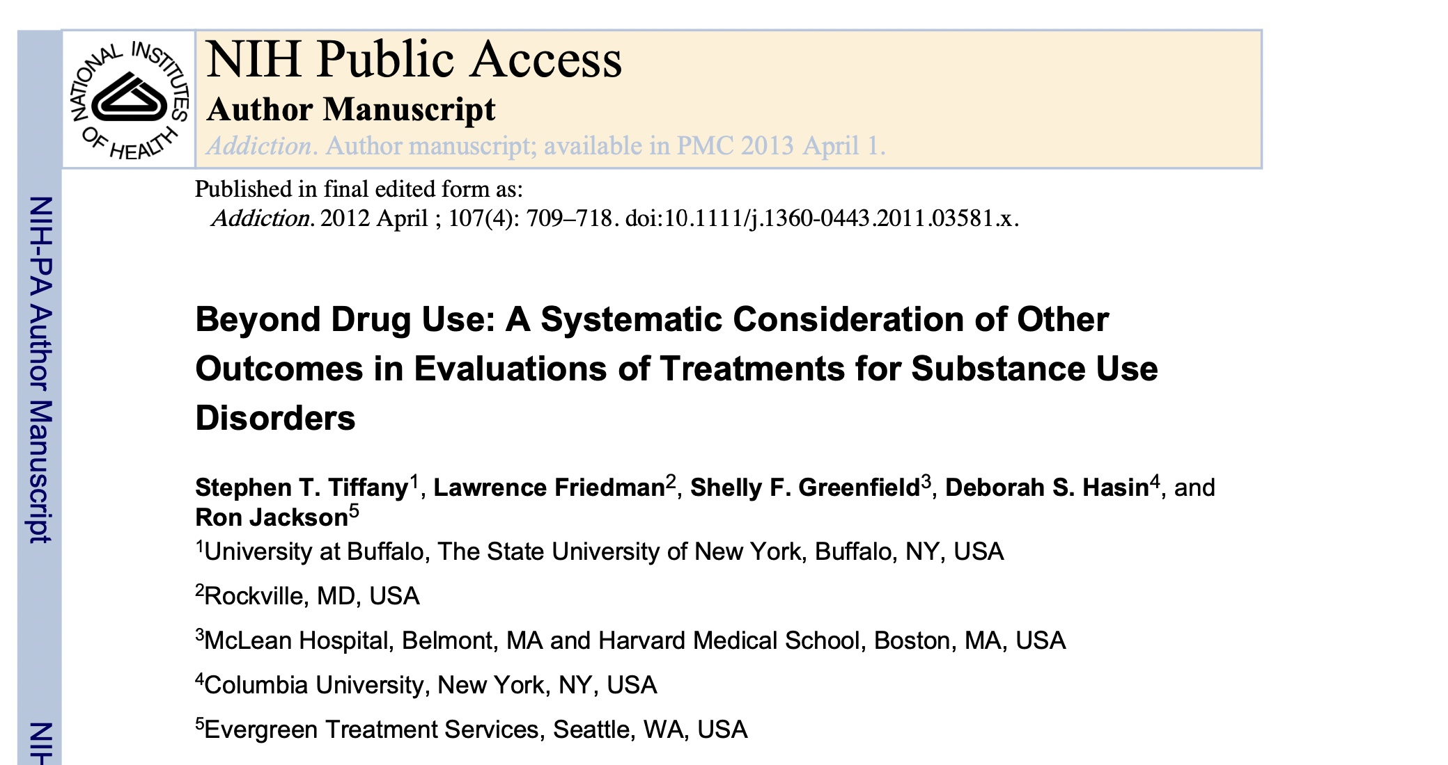
Other outcomes
Quality of Life
WHO-QUOL-BREF
Cravings
Cravings scales
Self-efficacy
Self-efficacy for abstaining from substances
Psychosocial functioning
CJI
Housing
Employment
Addiction Severity Index
What else?
RETENTION IN TREATMENT
Notes:
2012This paper is the result of the deliberations of a panel of substance abuse treatment and research experts convened by the National Institute on Drug Abuse to discuss appropriate outcome measures for clinical trials of substance use disorder treatments.
What I hope to illustrate today is that lifestyle interventions in treatment, and the existing data to support them, do include some of these outcomes, though not measured with validated scales per se, and that we should diligently work to increase access to funding and policy changes that affect treatment paradigms including length of stay and curriculum requirements and research opportunities that allow us to follow these treatment outcomes
SUD impacts the individual, the family, the community – getting people to stop using substances is just one tiny piece of the picture – rebuilding their lives and reintegrating them into their family and social systems is the hard work of treatment for the individual , the organizations, the infrastructure of treatment and the community – including criminal justice reform, funding, advocacy. Were so focused on just stop the drugs – how is that working out for us?
Outcomes focus on drug use primarily – time line feedback, urine drug screen, overdose, relapse – on an on about the drug use itself
How do we help people actually HEAL – Body, Mind and spirit, that is the question
Other outcomes have to be
1. A consequence of excessive drug use
2. clinical importance and relevance – tolerance is relevant to the development of a SUD, but it does not end up playing an important role in outcomes of treatment – we are NOT treating people to reduce tolerance – we are treating them to reduce cravings
3. The outcome is common across drugs of abuse – following a specific withdrawal symptom for patient with stimulant use disorder versus measuring an improvement in self efficacy – the withdrawal symptom would not be generalizable to all patients with SUD
4. Practical measures with documented, strong psychometric properties are available to assess the outcome. You have to have a GOOD TOOL for assessing treatment outcome – Who QUOL BREF, Addiction Severity Index – though very long and more difficult to administer and summarize
5. Treatment has to reliably alter the outcome – cessation of drug use can be measured more quickly than changes in quality of life, or self-efficacy – these changes take time – so then we run into the heart of the matter – funding, time in treatment, follow up, man power, etc etc – treatment determined by insurance companies, not doctors and clinicians
Never the less – these are important considerations and I would argue that the inclusion of lifestyle education and interventions in treatment across the continuum is an important component as it’s outcomes include improvement in all of these areas

Slide 15
Lack of current consideration in treatment – especially nutrition
1990 American Dietetic Association (Academy of Nutrition and Dietetics) position paper calling for nutrition intervention as essential in the treatment and recovery from SUD
2018 David Wiss and colleagues - Assessment of treatment centers in LA – less than 1/3 of treatment centers offered ANY nutrition intervention services and only 7% of those that did, utilized a registered dietician in their program
Wiss DA, Schellenberger M, Prelip ML Rapid assessment of nutrition services in Los Angeles substance use disorder treatment centers. J Community Health. 2018. https://doi.org/10.1007/s10900-018-0557-2
Notes:
Many treatment programs have curriculum that includes some lifestyle interventions, many include or require trips to the gym, or yoga, meditation , acupuncture for stress reduction, treatment is delivered in a group model, highlighting the importance of rebuilding social connections and the importance of shared experiences. However, attention to the delivery of supportive nutrition and education about nutrition is lacking. There is a significant void in the research as well.

Slide 16
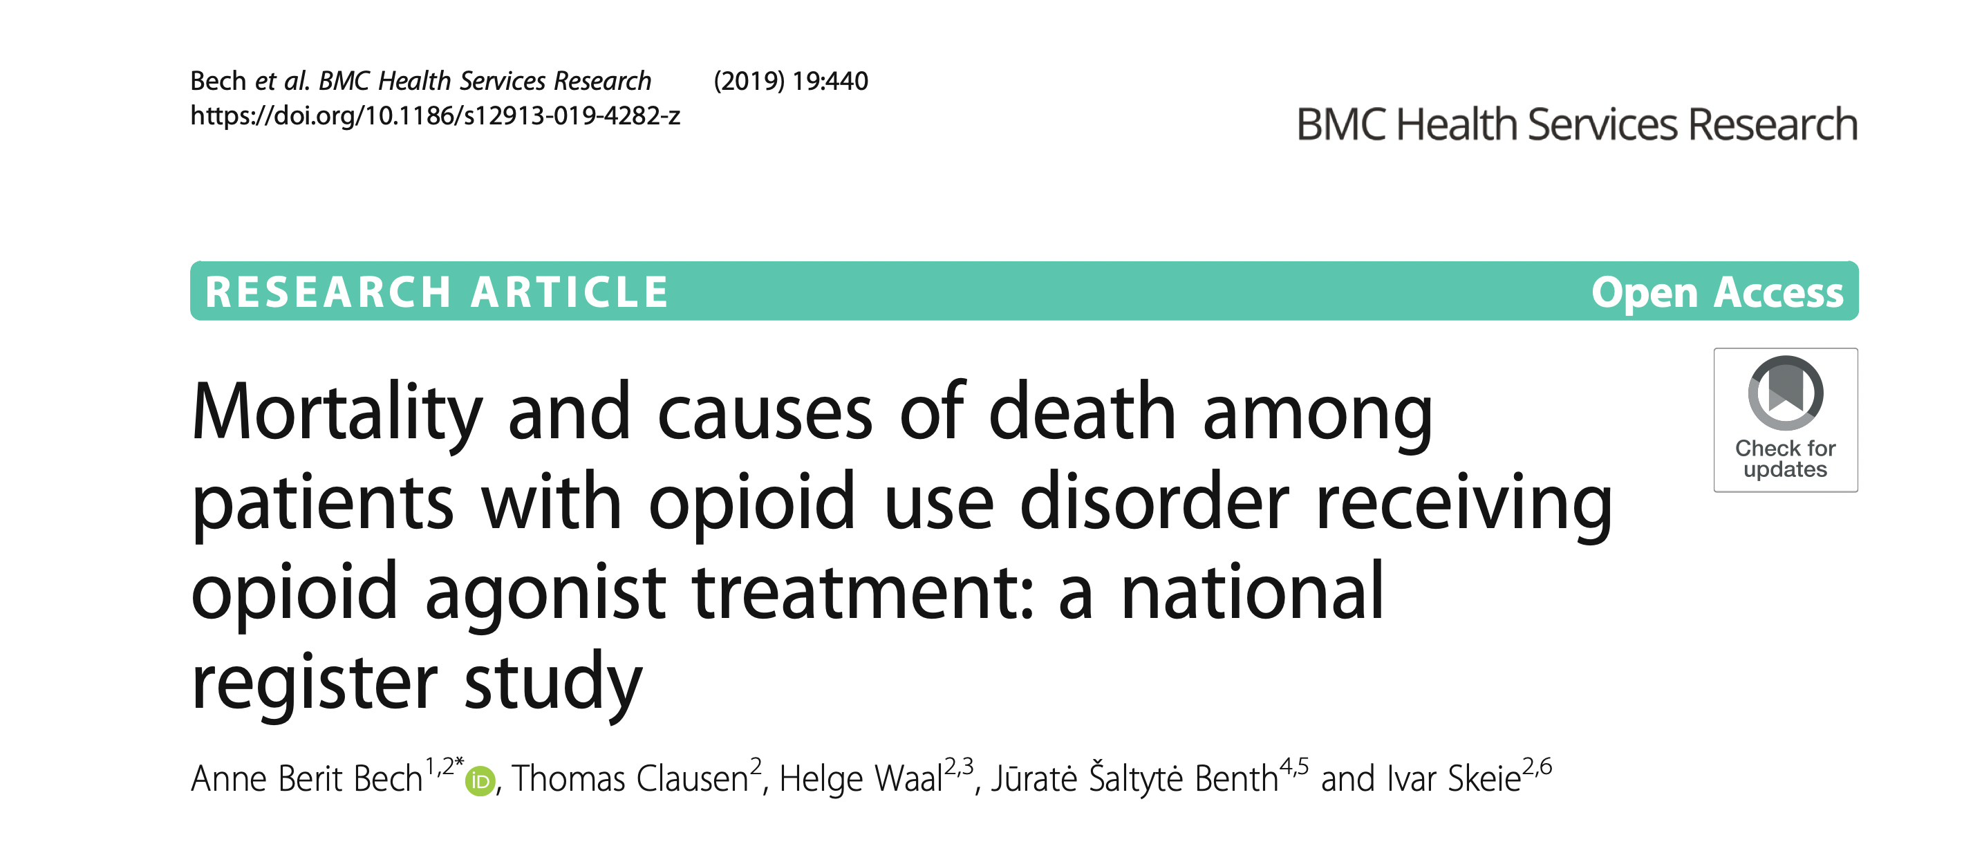
Poor nutrition and lifestyle is killing our patients
Notes:
These are two papers reporting causes of death and hospital admission for patients with SUD – the one on the right with the circles from London, the one on the left from Norway. These patients were using heroin on the right as well as other substances, but all using at least heroin, on then on the left, patient were on MOUD with a history of heroin use. In both studies the number of deaths directly related to drug use, overdose, accident, infection, were both less than the number of deaths related to somatic illness, meaning chronic disease related deaths. Both less than 50% related to drug use. The number one cause of death, cardiovascular disease, complications of GI related illness, not including substance related liver disease, pulmonary disease primarily COPD, which is of course from tobacco, but not directly related to opioid or other drug use, and cancers. These risks of death from somatic illness on the left were higher than for people who use drugs, in the darkly shaded areas, than for those who did not. So – people who use substances die more often from chronic disease than directly from their use, and they more often from these diseases than the general population. SO in my mind, were missing an opportunity to extend the quality and quantity of our patients in recovery by helping them to heal their bodies and reduce their risk of morbidity and mortality from these lifestyle related illnesses. Why are we not focused on this early in recovery, and beyond?

Slide 17
Risk of Death- Lifestyle related Deaths Have surpassed tobacco Deaths
Risk Factors
Notes:
Lifestyle related illnesses have finally surpassed tobacco related illness as a cause of death in our country.. We are dying of poor nutrition, sedentary lifestyle , and stress. Heart attacks, complications of Type 2 DM, obesity and lifestyle related cancers like breast, prostate and colon can all be mitigated with lifestyle interventions in our patients.
Tell the story of Kent Nielsen

Slide 18
Why are Lifestyle interventions important for SUD treatment?
Substance use causes increased cellular damage and impaired insulin sensitivity
Substance use increases risk of metabolic syndrome and risk of developing Type 2 Diabetes
SUD leads to inadequate dietary intake and malnutrition, including malnutrition associated with overeating of poor nutrient quality, highly palatable food
Many people with SUD report rapid onset of weight gain early in recovery
Weight related concerns are present in a high percentage of women in treatment for SUD and have been shown to contribute to return to use
Notes:
Lifestyle Interventions

Slide 19
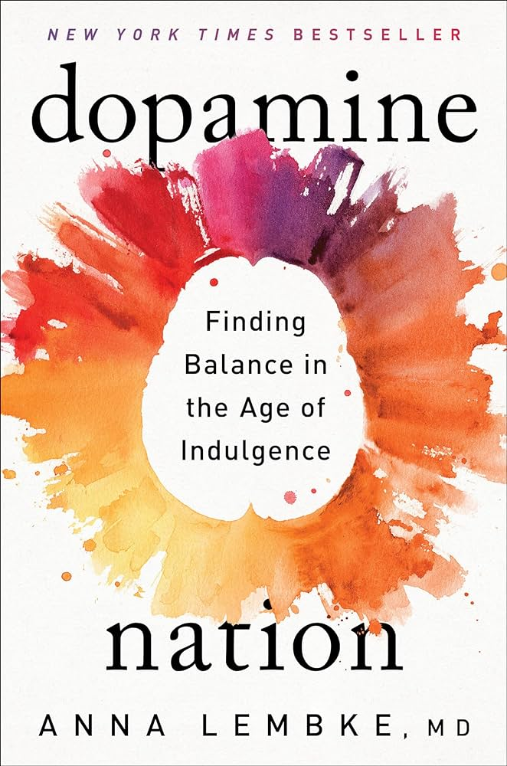
How Do we Restore Balance? Anna Lembke- Dopamine Nation
Exercising Ice Plunge
Intermittent fasting Cooking
Praying Gardening
Meditating Spending time with children
Caring for pets Writing a thank you note
Being in nature Saying we are sorry
Speaking with shopkeepers or baristas – no apps
Reading a hard book
Walking or biking instead of driving
Telling the truth
Reaching out to family and friends
Reaching out to old friends, parents, grandparents
Notes:
Paying the price for higher levels of dopamine – We have to unplug – from substances, processes, electronics- that deplete our dopamine and engage in activities that “teach our brain how to be happy again” – THIS IS AT IT’S ESSENCE THE HARD WORK OF RECOVERY

Slide 20
How do we do the hard work
Balancing blood sugar and insulin
Reducing inflammation
Healing the gut
Restoring circadian rhythm
Notes:
Modifiable lifestyle factors in Functional Medicine and Pillars of Lifestyle Medicine

Slide 21
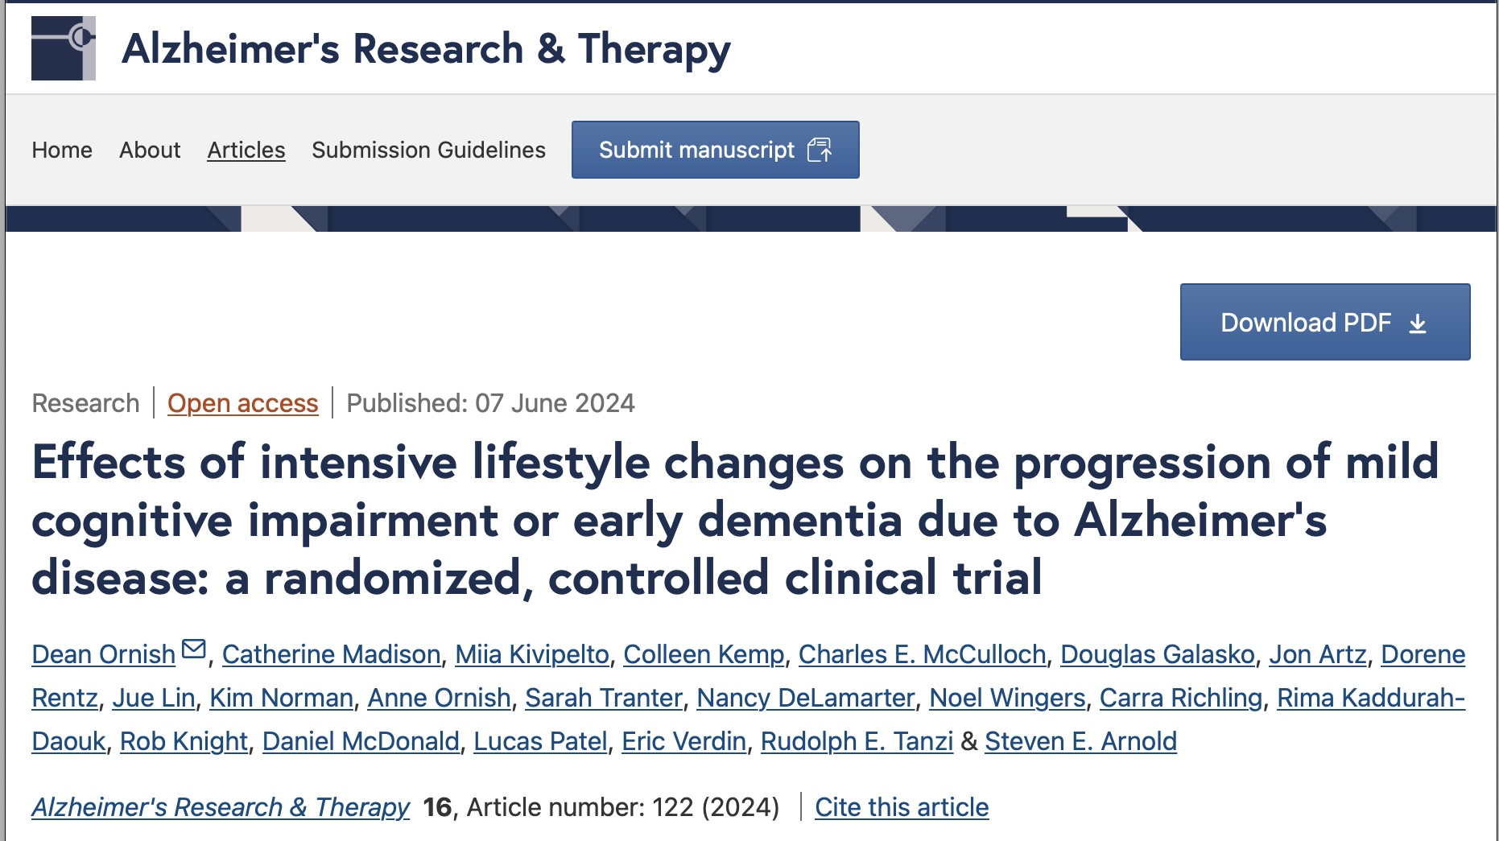
If you don’t believe that lifestyle changes can reverse chronic disease

Slide 22
Hungry angry lonely tired
Reduce cravings
Heal the body
Heal the mind
Heal the spirit
Notes:
Addiction should not be treated any different than any other chornic disease, and ALL chronic disease should be managed with a lifestyle approach in addition to medications, therapy, PT, etc, etc.

Slide 23
American’s Consume one Ton of food per year AND 60% of our diet is from HIGHLY Processed FOODS
Notes:
Catherine starts here

Slide 24
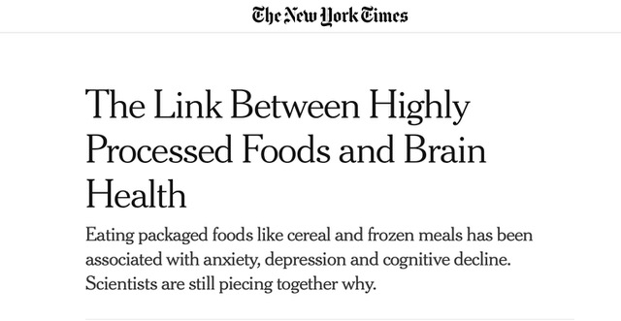
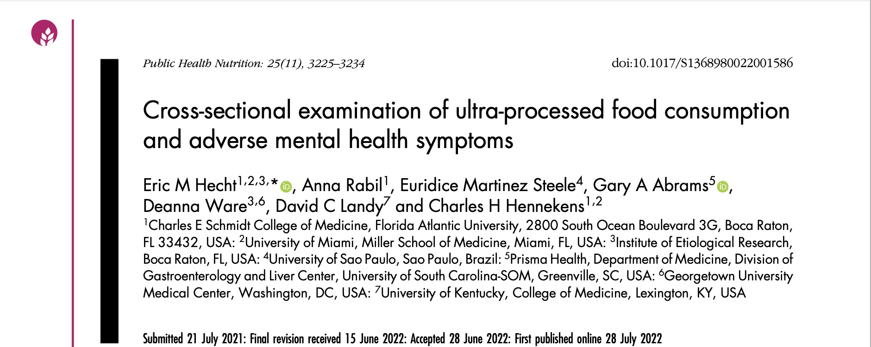
Correlation not causation
More mild depression
More mentally unhealthy days
More anxious days
Less likely to report zero mentally unhealthy days
Less likely to report no zero anxious days
Notes:
Amy

Slide 25
Studies
GEICO
SMILES
PREDIDEP
HELFIMED
Notes:
All of these studies are randomized controlled trials looking at the impact of high nutrient density foods- plants based, Mediterranean like nutrional interventions – on mood – and they all showed improved mood, less anxiety, increased work productivity and happiness at work, than standard eating patterns of processed foods and reliance on animal products.

Slide 26
How do nutritional interventions impact physical and mental health?
Cortisol and Appetite
Blood Sugar and Insulin
Gut Health – Microbiome
Inflammation
Brain-Derived Growth Factor

Slide 27
Rebound Appetite
DURING USE
HPA axis suppressed
Reduced CRF, ACTH and Cortisol
WITHDRAWAL OF SUBSTANCE
HPA axis ACTIVATED
Increased CRF, ACTH and Cortisol
Activated HPA axis and Cortisol leads to withdrawal symptoms
Anxiety, dysphoria, insomnia
Increased appetite
Cravings for high density foods and sweets
Chronically elevated cortisol leads to metabolic dysfunction
Weight gain and metabolic syndrome
Notes:
Does this look familiar ? Amy

Slide 28
Blood Sugar and Insulin HALT Hungry-Angry-Lonely-Tired

Slide 29
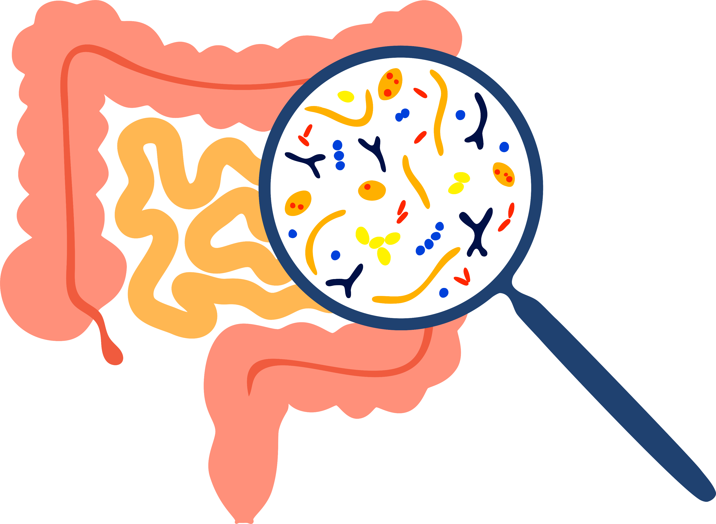
Gut microbiome
Decrease in short chain fatty acid producing microbes
More inflammatory microbes; less anti-inflammatory SCFA producing microbes
Decreased diversity
More microbes that are associated with poor health outcome
Interventional data shows increased fiber intake improves mood disorders.

Slide 30
Anti-inflammatory diet
Mediterranean Diet Score: Yes = 1 Point, No = 0 Points
Vegetables: 4 or more a day
Legumes: 1 or more servings a day
Nuts and seeds: 1 or more a week
Fruit: 2 or more a day
Green leafy vegetables: 4 or more servings a week
Fats: more unsaturated fats like avocados, nuts and seeds than saturated fats like butter
Red and processed meat: fewer than 2 servings a week
5 points or higher puts you in the range of the highest benefit. Scores less than 4 mean you are getting little or no protection.

Slide 31
Brain Derived Neurotrophic Factor (BDNF)
BDNF: Evidence that brain-derived neurotrophic factor (BDNF) plays a role in human depression. BDNF controls the growth of new nerve cells, which may explain atrophy of specific brain areas with low levels among depressed patients.
How can we increase BDNF?
Fruits and Veggies
Nuts and Seeds
Exercise
Being outside

Slide 32
Survey of nutritional services provided by SUD treatment programs in the VA system and outcomes of treatment assessment by the Addiction Severity Index
50% of programs offered nutritional education in a group setting
Group nutrition education was positively associated with reduction in ASI scores in the medical and psychiatric and family/social domains.
Conclusion – “Our findings reveal that nutrition education, particularly with a substance abuse treatment focus provided within a group setting, is associated with positive sub- stance abuse treatment outcomes and should be included as a component of substance abuse treatment. “
Grant LP et al. Nutrition education is positively associated with substance abuse treatment program outcomes. Journal of the American Dietetic Association. 2004;104:604-610.
Notes:
National survey of VA facilities with inpatient SUD treatment programs. 101, 68% of those surveyed responded. There was a wide variety of type of nutritional interventions. Programs that offered group nutrition education – which was not detailed in the study- versus those who did not offer group nutrition education- had statistically significant improvements in the psychiatric, medical, and family and social domains. Improvements in physical health, mental health and relational health which are domains that are also assessed in other quality of life type surveys.

Slide 33
Healthy Steps to Freedom
Notes:
The largest study of its kind that I found. The Healthy Steps to Freedom Program, started by a woman named Anne Lindsay, whose primary work has been in incarcerated women in Nevada. I spent some time talking with Anne a couple of eyars ago and certainly found a kindred spirit. She is so passionate about nutrtion and movement education for patients, especially women, with SUD, and feels that without widespread adoption of this type of education that it will be very difficult to continue to move the needle on SUD, especially methamphetamines. As our country become more obese, less healthy, the higher the risk of initiation and return to use of substances will become. She recognized early in her work that SUD, especially methamphetamine use, in women, is driven by body image and weight concerns. Initiation and return to use is often driven by concerns regarding weight. Her study group included 124 women in residential and outpatient SUD programs in Nevada, newly released from correctional institution. The intervention was an intenstive educational curriculum focused on nutrtion, movement, body image, and eating behaviors all in a group format. Women experienced slowed trajectory of weight gain in early recovery, improved body image, increased daily movement and intake of fruits and vegetables. This is helping people FEEL better.

Slide 34
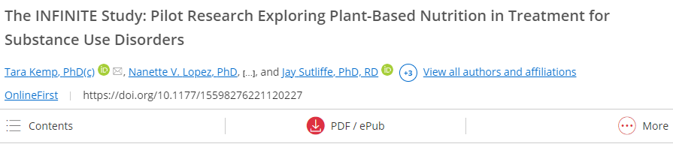
Dietary Interventions in SUD Treatment
WFPBD group maintained their healthy eating patterns to a greater degree than the control group when they left residential programming.
Increase in self-esteem in the WFPBD experimental group; similar to findings of a previous study where self-esteem was measured as an outcome of adopting a plant-based diet.
Greater resilience thought to prevent the low moods and poor self-image that might trigger a downward emotional spiral and leave them more susceptible to relapse.

Slide 35
Nutritional interventions in recovery
NUTRITIONAL RECOMMENDATIONS IN RECOVERY
How should we be feeding people in residential settings and beyond
How should we be counseling people to eat in early recovery and beyond
NUTRITIONAL EDUCATION IN RECOVERY
Feeding oneself is a life skill that many people do not have
People with SUD have not been feeding themselves for prolonged periods of time, if ever
Healthy nutrition and feeding requires MOTIVATION, MENTORING, STRUCTURE and CLOSE FOLLOW-UP

Slide 36
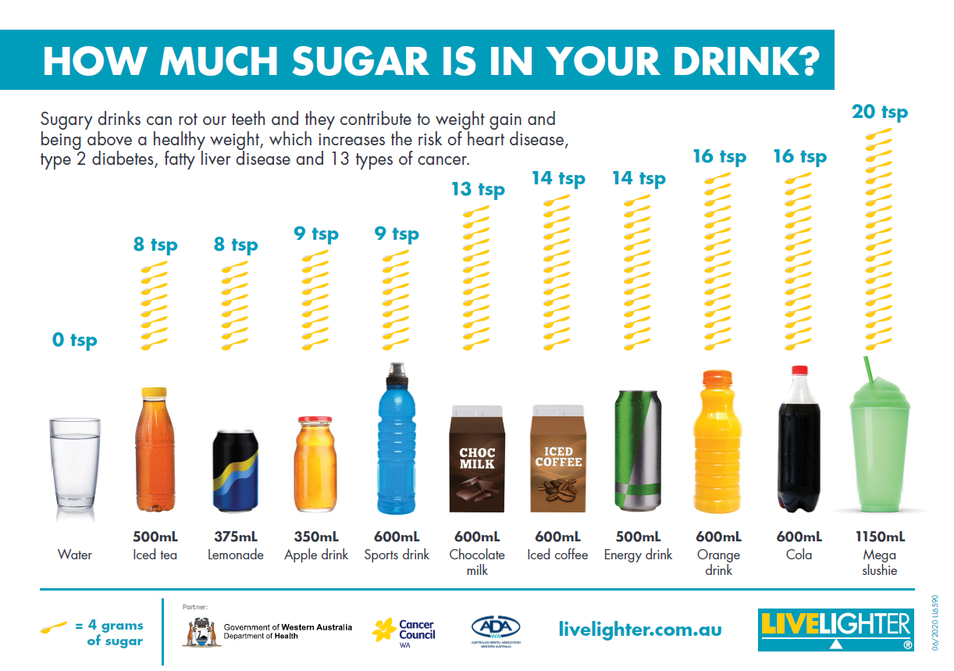
Remove Sugary Drinks
Women- no more than 6 teaspoons per day (24 grams)
Men – no more than 9 teaspoons per day (36 grams)
Average American consumed 38.87 gallons of soda in 2018
Frequent sugary drink consumption increases Type 2 DM, heart disease, fatty liver disease and premature death!
Notes:
THIS SAVES PEOPLE MONEY – 12 pack

Slide 37
ADD in Healthy Drinks
With still or sparkling water without added sugars
Green tea is an excellent anti-oxidant for gut, brain and heart health
Coffee is an antioxidant (but not with added milk, non-dairy cream or sugar)

Slide 38
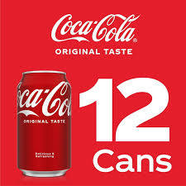
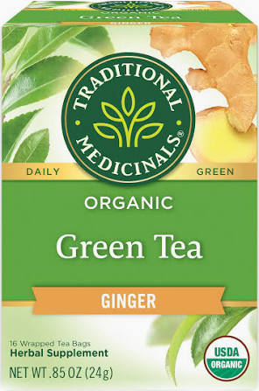
Cost comparison
Notes:
WalMart
12 pack coke 12.60
8 pack Waterloo 4.99
Grande Mocha Frapacchino 5.75
Ginger Green Tea 16 bags 5.99

Slide 39
High fiber – Happy Gut
Recommended daily fiber intake – 25-30 grams
Average American daily fiber intake – 7-15 grams
My recommendation – 50 grams!!!
Fruits and veggies
WHOLE grains – oats, rye, barley, farro, quinoa, buckwheat, polenta
Beans and legumes –chickpea, edamame, lentils, split peas
Nuts and seeds
START BY ADDING ONE FRUIT OR VEGETABLE WITH EACH MEAL

Slide 40
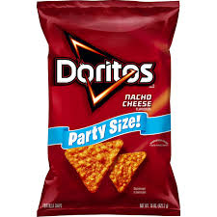
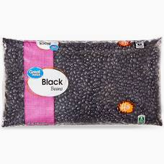
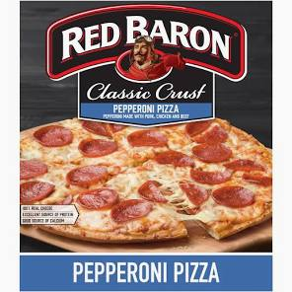
COST comparisons
Notes:
Wal Mart
Doritos party size 5.94 fiber 1.5 grams
5.58 5 pound bag of red delicious apples- 4.4 grams
Red Baron Pizza 4.82 – 4 servings – 2 grams of fiber
4 pound bag of dried black beans 4.88 – 7 cups cooked black beans per pound – 1 serving is officially 1/2 cup, most people probably eat a cup – so 7 servings per bag- 28 servings – 15 grams of fiber- 15 grams of protein

Slide 42
Sleep and Sud

Slide 43
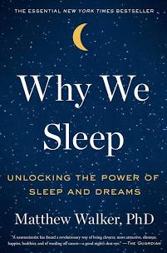
Sleep
Chronic use of substances leads to characteristic changes in sleep which can persist weeks into abstinence
Increase in sleep onset latency
Decreased total sleep time
Increased night wakening
Decreased Stage 3 slow wave sleep (memories and learning)
Decreased REM sleep (memories and physical restoration)
PERSISTENT SLEEP DISRUPTION IS A RISK FOR RETURN TO USE (HALT)
Notes:
ALL SUBSTANCES INTERRUPT SLEEP- even nicotine and cannabis!
Sleep loss equals type 2 DM, heart disease, hypertension, cancer, obesity, job loss, lost productivity, dementia - we are getting less sleep and less quality sleep
HALT Hungry angry lonely tired

Slide 44
Sleep interventions for your patients
Go to sleep and wake up at the same time everyday
Turn off devices at LEAST one hour before bed and DO NOT USE during night awakenings
Do not exercise within 2 hours of bedtime
Do not eat within 2 hours of bedtime
Develop a sleep ritual- warm bath or shower, hot tea, night-time walk
Use the bed ONLY for sleep, sex and sickness – getting out of bed if not sleeping
CBT-I !!!! Better than ANY medication – The VA says so!!!
Notes:
CBT-I COACH

Slide 45
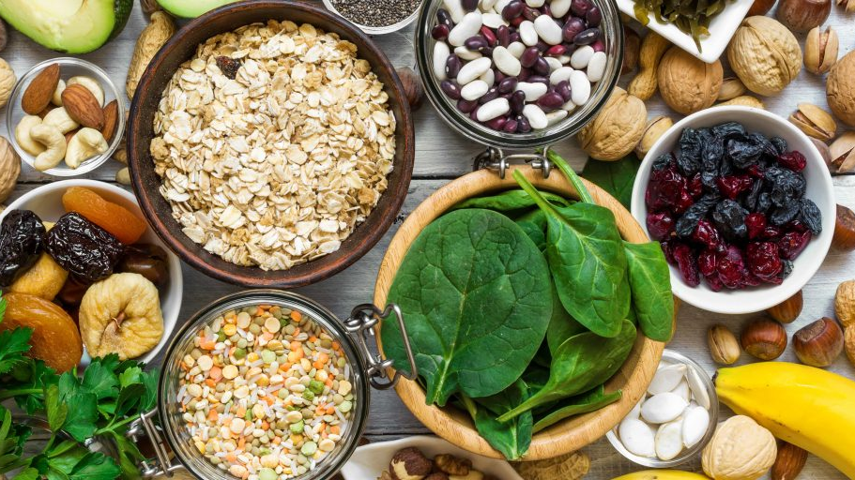
Magnesium
NMDA receptor antagonist – reduces glutamate excitation
GABA agonist – increases GABA inhibition
Notes:
I use magnesium both alone and in combination with melatonin for the treatment of insomnia. I almost always use it, even if patients are on a prescription sleeping medication. I feel like reducing glutamate and increasing GABA is probably helpful for just about all of my patients.

Slide 46
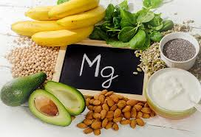
Magnesium
Magnesium rich foods
Magnesium Glycinate is my preferred formulation
Reduced GI effects- cramping and diarrhea
Uses
Insomnia 250-500 mg – either alone or in combination with melatonin or as adjunctive treatment with medication
Acute Alcohol Withdrawal 250 mg twice daily
Constipation for patients on buprenorphine – Magnesium Oxide 250 mg, increase as needed

Slide 47
MELATONIN
Start low and go slow to avoid negative side effects
Dosing
Melatonin should be taken at least 1-2 hours before bedtime, ideally at sundown
Start with 1 mg and gradually increase every 3-4 nights
Nightmares and Trauma
Notes:
I use melatonin often in my practice. Here are my thoughts on dosing. I use melatonin in women and men with hormone related issues, especially if they are young, as well as in patients with inflammatory disease.

Slide 48
EXERCISE AND SUD
Current public health guidelines for achieving the health benefits of exercise – 150 minutes per week (30 minutes 5 days per week) of moderate intensity exercise – increase heart-rate 40-60%- Talk but can’t sing
What does EXERCISE in studies do?
Reduced anxiety and depression – this is good for SUD
Reduced stress
Reduced cravings for alcohol
Longer duration of abstinence from alcohol
Reduced cocaine use
Improved physical activity and and reduced stress in OUD
Approximately 50% of people who start an exercise program drop out within 6 months, or do not exercise sufficiently to get the benefits – :(
Notes:
Exercise can be difficult to study. Many different types of interventions, how do you make sure everyone is achieving the same intensity of exercise, poor adherence rates for structured group exercise, even in residential or IOP settings
This is the type of exercise that is “recommended” by multiple organization for typical cardiovascular benefits. Exercise Prescriptions like 30-40 minutes of moderate intensity exercise most days of the week, with some days of strength training, some days of stretching- blah blah blah. Who is early recovery, or even later in recovery, is going to actually follow through with this?Studies often don’t prescribe a sufficient amount of exercise to achieve benefits of prescribed exercise, AND they have VERY poor adherance

Slide 49
Movement
Exercise- physical movement that is planned, structured and repetitive
Physical Activity – Any movement that uses muscles and expends energy
Walking
Cleaning
Yardwork
Climbing stairs
ANY MOVEMENT IS BETTER THAN NO MOVEMENT
Notes:
US Centers for Disease Control and Prevention says that physical activity of any kind, including structured moderate to vigorous activity is good for our health

Slide 50
Benefits of walking FREE FREE FREE
Walking 30 minutes per day
reduce your risk of heart disease and stroke (35%)
manage weight, blood pressure and blood cholesterol
prevent and control diabetes (reduces risk of T2DM 40%)
reduce risk of developing some cancers
maintain bone density, reducing your risk of osteoporosis and fractures
improve balance and coordination, reducing risk of falls and other injuries
improve daily mood which cumulatively leads to better mental health
Notes:
Start with just 10 minutes per day of walking! Walk with a friend or family member, including the dog. Walking AND enjoying the company of other people.

Slide 51
Yoga as movement FREE FREE FREE
Check out Yoga for Beginners
https://youtu.be/v7AYKMP6rOE

Slide 52
Reducing Stress Reduces hALT

Slide 53
5-Needle Protocol
Notes:
Nada training in Utah until this year has only been offered to DO, MD, chiropractors and Licensed acupuncturists

Slide 54
Evidence overview
Carter et al. 2017 - improves quality of life, reduction of mental and physical symptoms, reduction of alcohol and nicotine use
Baker et al. 2016 - improves retention for treatment of OUD
Stuyt et al. 2016 - improves treatment outcomes when used a complimentary method to standard treatment
Chang et al. 2014 - improved cravings and anxiety in Veterans
Avants et al. 2000 - adjunctive use for treatment of cocaine use disorder
Janssen et al. 2005 - effective in harm reduction settings

Slide 55
Odyssey House auricular acupuncture Quality Improvement Study
August 2020 to May 2021
Orientation/Covid quarantine Units
Residential Adult Facility
Delivered in a group setting among 7 cohorts, 7-16 adults per cohort
Needles placed for approximately 30 minutes, not observed
Short processing done after session

Slide 56
QI study
10-point likert scale assessing 5 domains filled out before and after treatment
Anxiety
Irritability
Pain
Cravings
Motivation for Treatment

Slide 57
RTC Survey Data
Post-Acupuncture Data
N= 71
Cravings
Anxiety
Irritability
Pain
Motivation for receiving addiction treatment
Notes:
Treatments from: 9/29/20 – 2/4/21
Did about 70 treatments twice per week
Data includes at least first 2 treatments per patient
NOTE: The labels said ”irritability” for question three rather than “withdrawal” recorded for NADA cohort data

Slide 58
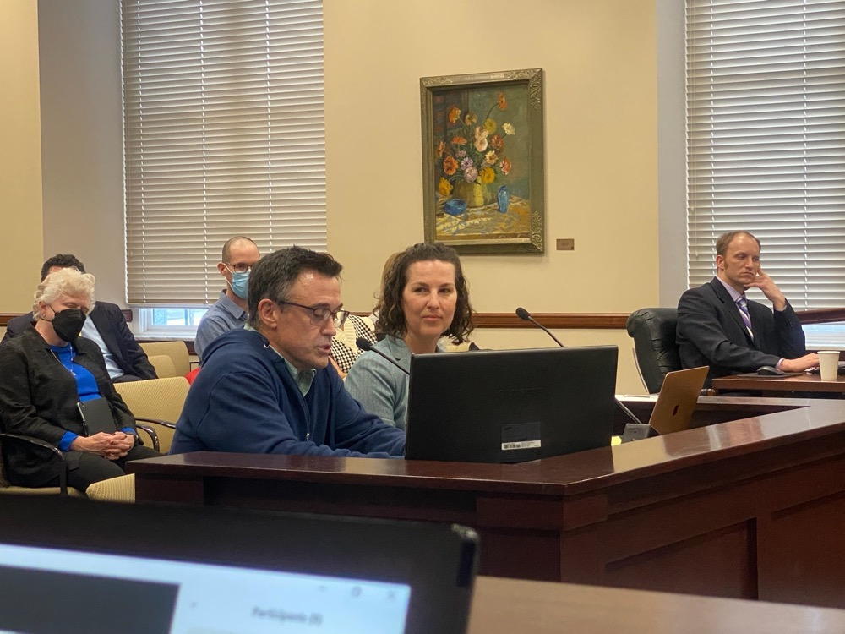
House Bill 195 Auricular Detoxification Amendments
Notes:
Passed out of the House 66 to 2
Unanimously out of the Senate

Slide 59
Contemplative practices
Even 5 minutes per day of meditation reduces cortisol and and improves well being

Slide 60
Connectivity and the Group Medical Visit
Dr. Jeff Geller 23 years of experience in developing, facilitating, researching and training providers in the development and delivery of the Group Medical Visit
Integrated Center for Group Medical Visits - MISSION
To help create a world where all people have access to evidence based integrated primary care, including group medical visit models facilitated by outstanding providers trained in group medical care.
Randi Sokul – developed online GMV for buprenorphine during COVID – XBOT – buprenorphine, processing and psychoeducation
Notes:
Dr. Geller- Lawrence , MA.

Slide 61
“Old wisdom from the recovery community would suggest that a liberalized approach to sweets, nicotine and caffeine is favorable to help the individual get past the immediate crisis. New wisdom suggests that this behavior is a form of cross addiction that should be addressed early in recovery.” David Wiss MS RDN

Slide 62
Implementation of Integrative and Lifestyle medicine into treatment programming

Slide 63
Wellness In Recovery Program- OH
12 -week lifestyle curriculum delivered to a cohort of 8 clients in residential programming at Lighthouse
6 patients completed the program
1 hour meeting per week including a short didactic, food tasting or demonstration, and processing/discussion
Weight followed each week
Pre and post labs - CMP, A1C, Lipids and hsCRP and Quality of Life survey
Patients from 2 cohorts picked out a plant-based meal to cook 2 times per week as a substitute for meals as usual for the entire house (50 clients)
Peloton application purchased and installed on smart TV for all 7 cohorts

Slide 64
Wellness in recovery curriculum
Healthy Sleep
Importance of movement
Anti-inflammatory foods
Building a healthy smoothie
Trying new foods
Wrap up and review

Slide 65
Wellness in recovery curriculum
Building a healthy plate
Square Breathing Technique
HPA axis, stress and the role of cortisol in SUD
Insulin Resistance
Lab review - group lab review and education
Gut Health

Slide 66
REsults
4 of 6 patients lost weight, one patient increased to healthy weight, 1patient gained weight
4 of 6 patients had a reduction in A1C
3 of 6 patients had reduced total cholesterol but one was started on statin
2 of 6 had reduced triglycerides
1 patient had 1 point improvement in HDL, all of the rest had reduction in HDL
4 patients had reduction in LDL but one was started on statin

Slide 67
Results
Decreased pain
Decreased fatigue
Decreased depression and anxiety
Improved satisfaction with health
Improved sleep
Improved satisfaction with appearance

Slide 68
Implementation of Lifestyle Program
Stage 1
Engaging leadership and staff to assess readiness and motivation for integration of lifestyle education and interventions into existing programming
Stage 2
Evaluation of current programming with leadership and clinicians
Development of lifestyle program integration

Slide 69
Implementation of Lifestyle Program
Stage 3
Staff experience with lifestyle curriculum
10-12 weeks
Ideally 1 hour per week of in person or video presentation and processing
Weekly challenges
Weekly progress tracking
Integration of what staff is learning INTO patient care – how can we take what you are learning and start to apply it to how you are caring for patients everyday in your respective roles?

Slide 70
Implementation of Lifestyle Program
Stage 4- Running concurrently with Stage 3
Development of 8 Modules to be delivered to each client during their treatment event – video, handouts, manual, tracking
Once weekly in person 120- minute group with patients – education, processing, food demonstration/cooking
One 60 minute zoom check-in with patients – education and processing
Weekly meeting with chef
Ongoing weekly discussions with staff

Slide 71
Week 1: Setting Intentions
Education: The Importance of IBH
Exercise: The 7 Whys – Handout
Food Demo: Quick and easy breakfast options – smoothies and overnight oats with berries
Challenge: Have berries with breakfast 5 out of 7 days
Week 2: Introduction to Mindfulness
Education: HALT
Exercise: Mindful Eating – Urge Surfing
Food Demo: Meal Prep for nutritious lunch options
Challenge: Regulation of HPF late at night. Use urge surfing. No snacks after 7 pm.
Week 3: Movement
Education: Regulate Mood using Movement
Exercise: SMART FITT Goal
Food Demo: Healthy Snack Foods
Challenge: Move your body 20 mins a day with your movement of choice (yoga, stretching, walking, gym)

Slide 72
Implementation of Lifestyle Program
Stage 5- Data Collection and Evaluation
Perhaps the most important piece – how is this working?
Pre, mid and post curriculum evaluation
Self-efficacy
Nutrition literacy
Quality of life
Treatment retention

Slide 73
Thank you!
Amy de la Garza
amydelagarza@mac.com
Utah Acudetox
For information about ear acupuncture training, community sessions, and all things 5 Needle Protocol!
Utahacudetox.com
Feel free to reach out to me with questions!

Slide 74
References
Lewer D, Tweed EJ, Aldridge RW, Morley KI. Causes of hospital admission and mortality among 6683 people who use heroin: A cohort study comparing relative and absolute risks. Drug and Alcohol Dependence. 2019 Nov;204: 1-5.
Bech AB, et al. Mortality and causes of death among patients with opioid use disorder receiving opioid agonist treatment: A national register study. BMC Health Services Research. 2019 Jul;19(1)DOI:10.1186/s12913-019-4282-z.

Slide 75
REFERENCES- acupuncture
Baker TE, Chang G. The use of auricular acupuncture in opioid use disorder: A systematic literature review. Am J Addict. 2016 Dec;25(8):592-602. doi: 10.1111/ajad.12453. Epub 2016 Nov 2. PMID: 28051842.
Stuyt EB, Voyles CA. The National Acupuncture Detoxification Association protocol, auricular acupuncture to support patients with substance abuse and behavioral health disorders: current perspectives. Subst Abuse Rehabil. 2016;7:169-180. Published 2016 Dec 7. doi:10.2147/SAR.S99161
Carter, K., Olshan-Perlmutter, M., Marx, J., Martini, J. F., & Cairns, S. B. (2017). NADA Ear Acupuncture: An Adjunctive Therapy to Improve and Maintain Positive Outcomes in Substance Abuse Treatment. Behavioral sciences (Basel, Switzerland), 7(2), 37. https://doi.org/10.3390/bs7020037
Center for Substance Abuse Treatment. Center for Substance Abuse Treatment Detoxification and Substance Treatment; TIP series 45 (DHHSPublicationNo. [SMA] 06-4131); Substance Abuse and Mental Health Services: Rockville, MD, USA, 2006.

Slide 76
REFERENCES – Acupuncture cont.
Avants SK, Margolin A, Holford TR, Kosten TR. A randomized controlled trial of auricular acupuncture for cocaine dependence. Arch Intern Med. 2000 Aug 14-28;160(15):2305-12. doi: 10.1001/archinte.160.15.2305. PMID: 10927727.
Chang BH, Sommers E. Acupuncture and relaxation response for craving and anxiety reduction among military veterans in recovery from substance use disorder. Am J Addict. 2014 Mar-Apr;23(2):129-36. doi: 10.1111/j.1521-0391.2013.12079.x. Epub 2013 Aug 30. PMID: 25187049.
Janssen, P. A., Demorest, L. C., & Whynot, E. M. (2005). Acupuncture for substance abuse treatment in the Downtown Eastside of Vancouver. Journal of urban health : bulletin of the New York Academy of Medicine, 82(2), 285–295. https://doi.org/10.1093/jurban/jti054

Slide 77
References- Nutrition
Ahmad, F and Anderson, R. The leading causes of death in the US for 2020. JAMA. Published online March 31, 2021. doi:10.1001/jama.2021.5469
Meckel KR, Kiraly DD. A potential role for the gut microbiome in substance use disorder. Psychopharmacology (Berl). 2019 May;236(5):1513-1530.
Ren, M and Lotifipour, S. The role of the gut microbiome in opioid use. Behav Pharmacol. 2020 April;31(2):113-121.
Sanil, R. (2020, November 19) Gut microbiome and depression- pathophysiology, role of pre and probiotics. https://psychscenehub.com/psychinsights/gut-microbiome-and-depression-pathophysiology-role-of-pre-and-probiotics-2/
Taylor, AM and Holscher HD. A Review of Dietary and Microbial Connections to Depression, Anxiety, and Stress. Neurosci. 2020 Mar;23(3):237-250.doi: 10.1080/1028415X.2018.1493808.
Virmani, A et al. Links between nutrition, drug abuse, and the metabolic syndrome. Ann N Y Acad Sci. 2006 Aug;1074:303-14.doi: 10.1196/annals.1369.027.
Wiss, David, 2019 ‘The role of nutrition in addiction and recovery: What we know and don’t know’, in The Assessment and Treatment of Addiction, Best Practices and New Frontiers. Elsevier, Missouri, 21-42.

Slide 78
References-Nutrition
Zinocker, MK and Lindseth, IA. The Western Diet-Microbiome-Host interaction and its role in metabolic disease. Nutrients. 2018 Mar 17;10(3):365.doi: 10.3390/nu10030365.

Slide 79
References - exercise
Abrantes AM, Blevins CE. Exercise in the context of substance use treatment:key issues and future directions. Curr Opin Psych 2019;30:103-108,.
Weinstock J, et al. Exercise as an adjunctive treatment for substance use disorders: Rationale and Intervention Description. J Subst Abuse Treat. 2017 Jan;72:40-47.

