Slide 1
Idaho Law Enforcement Diversion (ILED) Initiative
Idaho’s version of diversion for drug-related crimes

Slide 2
Federal Acknowledgement
This presentation is supported by the Centers for Disease Control and Prevention (CDC) of the U.S. Department of Health and Human Services (HHS) as part of a financial assistance award totaling $11,600,000 for Capacity Building for Public Health Analysts in the Overdose Response Strategy with 100 percent funded by CDC/HHS. The contents are those of the author(s) and do not necessarily represent the official views of, nor an endorsement, by CDC/HHS, or the U.S. Government.
Notes:
Federal Acknowledgement - This presentation is supported by the Centers for Disease Control and Prevention (CDC) of the U.S. Department of Health and Human Services (HHS) as part of a financial assistance award totaling $11,600,000 with 100 percent funded by CDC/HHS. The contents are those of the author(s) and do not necessarily represent the official views of, nor an endorsement, by CDC/HHS, or the U.S. Government.

Slide 3
Learning Objectives
Understand how Idaho communities are implementing pre-arrest diversion, pre-trial diversion, and deflection programs under the umbrella of ILED.
Learn how to implement a diversion program in your community.
Know how to access help if you are interested in implementing a diversion program in your community.

Slide 4
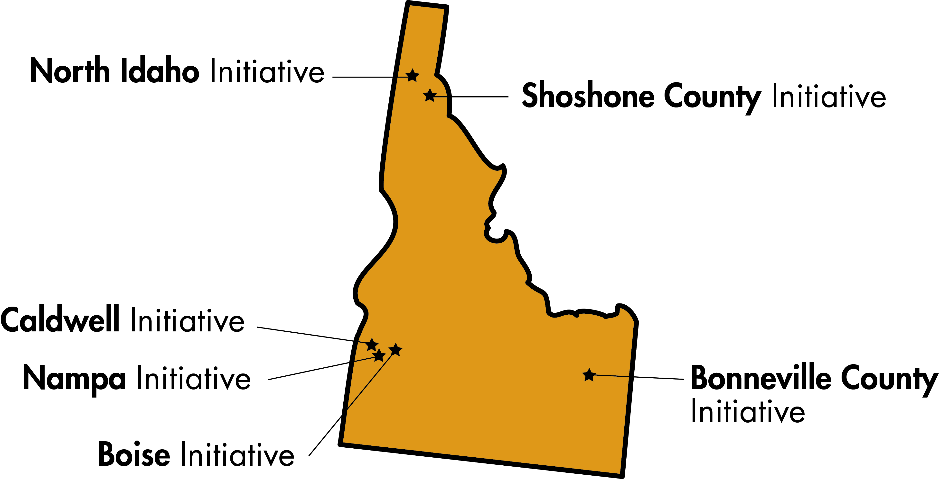
What is ILED?
ILED is a statewide framework for local pre-arrest and pre-prosecution diversion initiatives.
Each program has unique policies and procedures.
Launched in summer 2022, but Boise PD started the first diversion program in 2019.

Slide 5
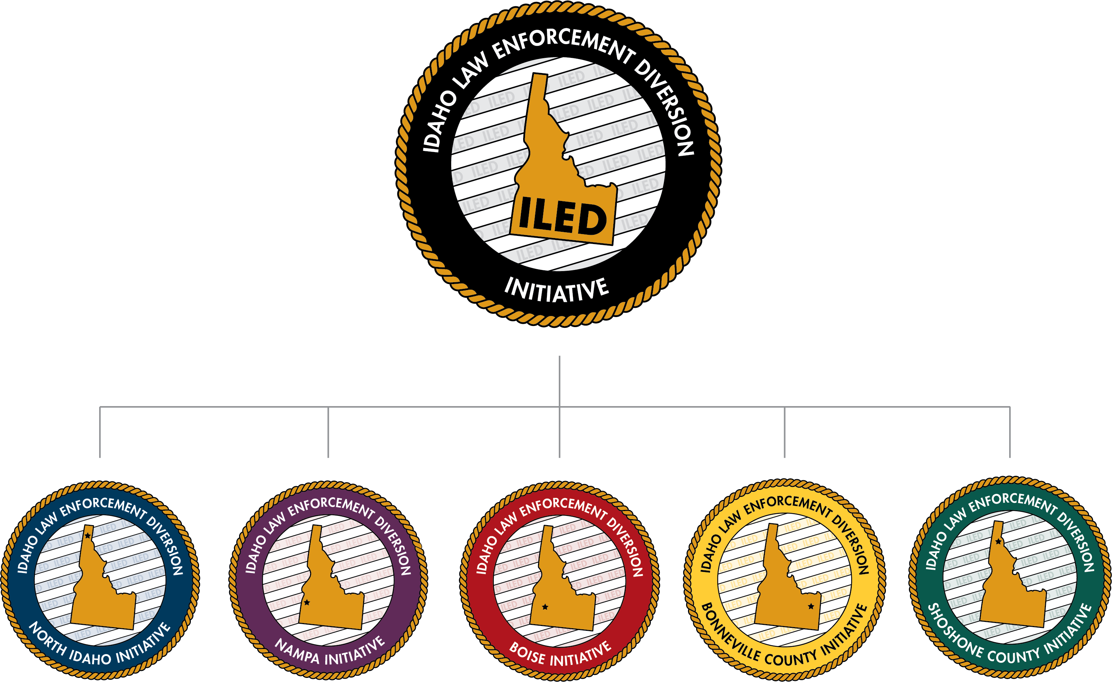

Slide 6
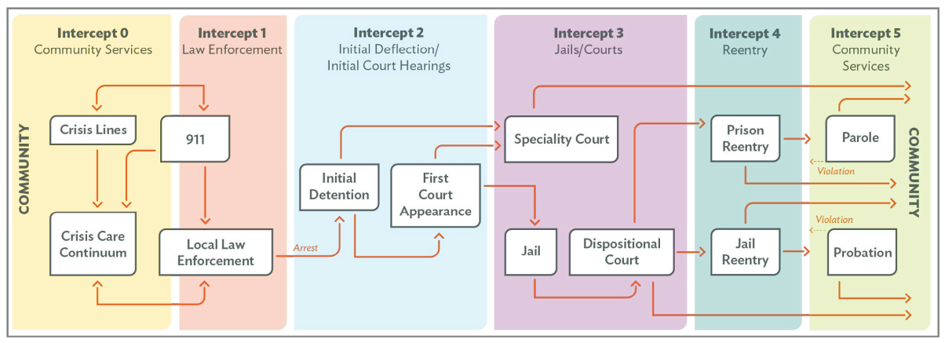
Sequential Intercept Model
Source: The National Council, An Overview of Deflection and Pre-Arrest Diversion to Prevent Opioid Overdose
Notes:
“The Sequential Intercept Model (SIM) details how individuals with mental and substance use disorders come into contact with and move through the criminal justice system.” – SAMHSA: The Sequential Intercept Model (SIM) https://www.samhsa.gov/criminal-juvenile-justice/sim-overview
Depending on an individual program’s model and policies, most FRD/PAD programs occur at Intercept 0 or 1, in lieu of arrest, detainment, and detention.
Even initial detention and initial court hearings (Intercept 3) can disrupt an individual’s stability, including employment and family/personal life, so FRD/PAD programs can reduce harm to PWUD by deferring them away from the criminal justice system.

Slide 7
Need and Rationale
Substance use disorders are common among criminal-justice involved populations.
Opioid overdose is the leading cause of death among individuals released from prison or jail.
Deflection and diversion may prevent individuals from acquiring a formal arrest record that can obstruct employment, well-being, and recovery.
Notes:
Mention drug laws too

Slide 8
ILED Outcomes and Goals
Short Term Outcomes | Prevent arrest and creation of a criminal record, or addition of a felony charge to an existing criminal record, for possession of user amounts of controlled substances. Reduce negative impacts of criminal justice system encounters. Improve law enforcement workload by freeing up time and resources to focus on more serious drug-related crimes.
Intermediate outcomes | Increase utilization of non-emergency substance use and behavioral health treatment and services. Reduce utilization of emergency services. Improve quality of life for ILED participants. Reduce recidivism for ILED participants.
Long Term outcomes | Reduce substance use and drug overdose for ILED participants. Reduce stigma and compassion fatigue among law enforcement officers towards people with substance use order. Reduce costs for the criminal justice system as compared to traditional booking and processing.

Slide 9
Local partners
Law enforcement
Public Health Districts
Prosecuting Attorneys
Treatment providers
Harm reduction / recovery centers
Probation Services
Case manager (probation officer or a social worker)

Slide 10
Eligibility Criteria Example – Shoshone County
QUALIFYING OFFENSES: | Any felony offense for use or abuse of a controlled substance was a primary factor in the offense Unlawful possession of a controlled substance Unlawful possession of paraphernalia
DISQUALIFIERS FROM ELIGIBILITY: | Crimes involving a firearm Offenses committed by minors | Trafficking in controlled substances Possession with intent to deliver
FACTORS DECREASING COMPETITIVENESS FOR ELIGIBILITY:* | DUIs Crime of violence or personal injury (crime with victim) Currently on probation or parole Registered sex offenders Confidential Informants | Active “Protection Order” or ”No Contact Order” Prior felony convictions within the past 10 years New disqualifying charge while in ILED Evasion of Law Enforcement or dishonesty about possession at the time of initial contact
FACTORS INCREASING COMPETITIVENESS FOR ELIGIBILITY: | Ties to the community Peer / family / social support systems in place Minimum felony level criminal history Cooperation with law enforcement and/or investigative processes Stable housing Lawful employment | Active civic service engagement Previous success in diversion and/or specialty treatment courts Previous successful completion of probation Honesty with Law Enforcement about possession at the time of initial contact
Referrals are considered on a case-by-case basis.
Notes:
Criteria is all legal- officers are not responsible for determining whether someone has a SUD diagnosis

Slide 11
Referral Procedures
Pre-Arrest / Law Enforcement Diversion
Law enforcement identifies a potential candidate at the scene and gives them instructions to contact the ILED case manager with a certain time period.
Intake with Case Manager and Assessment with Treatment Provider.
Pre-Trial / Prosecutor Diversion
Individual is taken into custody and Prosecuting Attorney reviews their case, with input from law enforcement.
Intake with Case Manager and Assessment with Treatment Provider.

Slide 12
Treatment
Case manager helps participants sign up for medical insurance during intake.
Local treatment providers are often able to expedite treatment access for this population.
Providers provide progress updates at ILED meetings.
ILED programs strive to provide all SUD treatment modalities.
Referrals made for other medical care as needed.

Slide 13
Graduation and Dismissal Policies
Graduation:
Complete program in ~12 months
Abstinence is not necessarily required for participation in ILED, but participant must have 90 days of negative UA tests prior to graduation.
Original charges are dismissed (never filed) or reduced
Dismissal:
May be due to lack of follow-through or communication with ILED team, multiple missed appointments, or serious violations of the signed Behavior Contract.
Entire ILED team votes and there must be a majority vote to dismiss.
Law enforcement and Prosecuting Attorney proceed with charges.
Participant can continue in treatment even if they are dismissed from ILED.

Slide 14
ILED By the Numbers
ILED Initiatives generally have small case loads (3-5 participants at a time)
Narrow eligibility criteria
Pilot programs
Eligibility expansions occurring! (misdemeanor referrals, noncriminal deflection, etc.)
We aim to conduct a formal statewide evaluation in the future.
ILED Graduates to Date:
Nampa: 10
Bonneville: 1
North Idaho: 3
Boise: 12

Slide 15
Success Stories
“This is an amazing opportunity to regain control of your life. Embrace it.”
– ILED graduate, advice to future ILED participants
Participant “was proud to say that she is 65 days sober. She stated that this is the longest she has been able to stay sober in the community.”
– Case manager update, week 10 in ILED
“When asked about what has changed in her life since being in this program, [the participant] stated ‘everything.’”
– Case manager update, week 4 in ILED

Slide 16
Success Stories
“ILED was my blessing in disguise. It not only saved my life, but it saved my sons by helping me end generational trauma and addiction. I’ll forever be so thankful to have been given a second chance to live a life and to be a mom.”
- ILED graduate

Slide 17
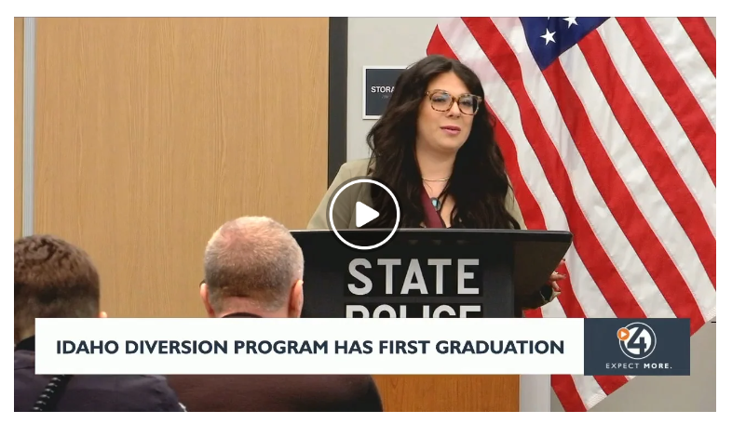
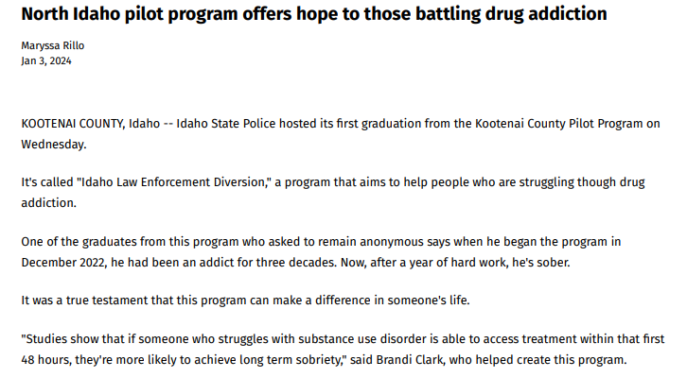

Slide 18
Success Stories
“Getting the privilege to manage the program for the Nampa Police Department can wear on you emotionally. The participants successes are yours as well as their failures. It’s much like being a parent. There have been many times where I wanted to give up on a person, but then they pulled through. Then there are times eventually I came to the realization that the person was not going to engage in the program and then had to make the decision to discharge or arrest that subject.
In conclusion, taking on this program for my department has been a struggle for me at times, but I would do it all again.”
- Nampa Police Department Corporal, ILED Coordinator

Slide 19
Interested in starting a diversion program in your community?
We can help!
Get support from other ILED Initiatives
Adapt existing program/court documents
Technical assistance available
Opioid settlement funds can be used for diversion. Federal grants for diversion exist as well.

Slide 20
Karyn Kershaw, MPH
Public Health Analyst, Idaho
CDC Foundation
karyn.kershaw@dhw.Idaho.gov
(404) 398-8244

Slide 21
Questions?

